Slide 1
Test Plan

Slide 2
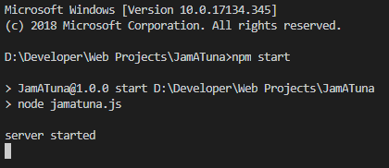
Run Server
Run the following commands in the project directory
npm install
npm start

Slide 3
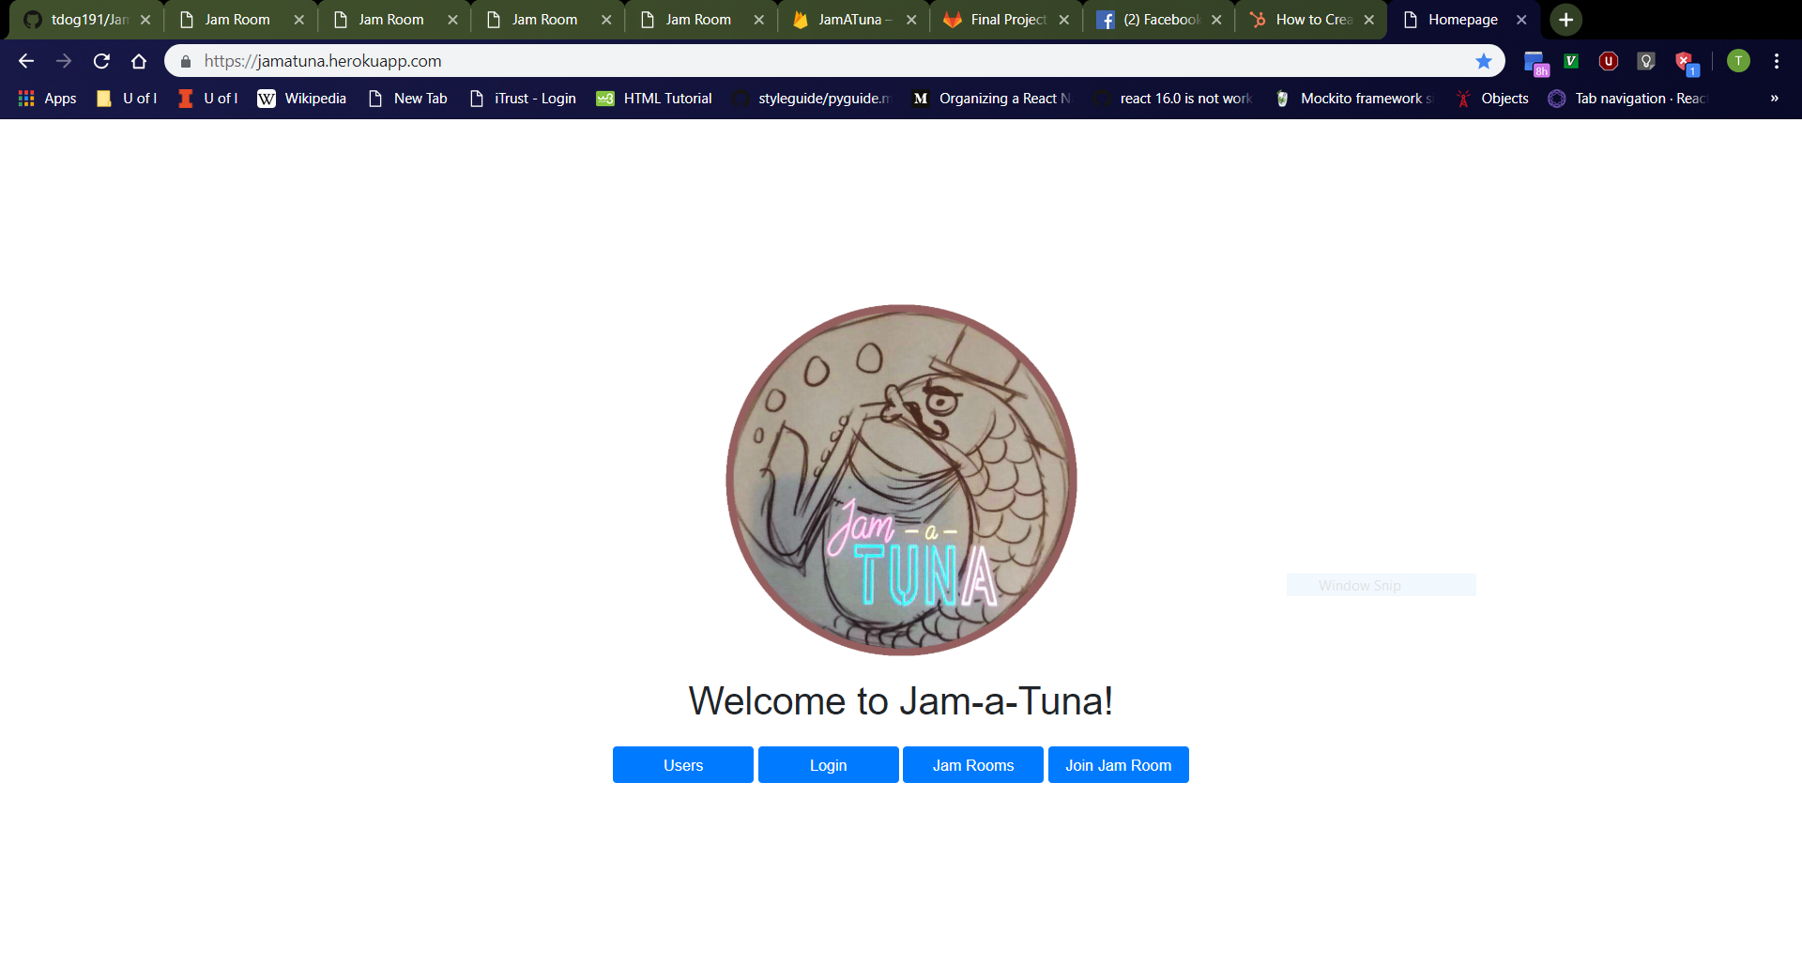
Home Page
Navigate to http://localhost:3000/
Should see Jam-a-Tuna image, text, and buttons
All buttons should work by taking you to a new page
Page should be centered in middle of browser
Should NOT see “Profile” and “Logout” buttons upon first visit to website in tab because no login has happened yet

Slide 4
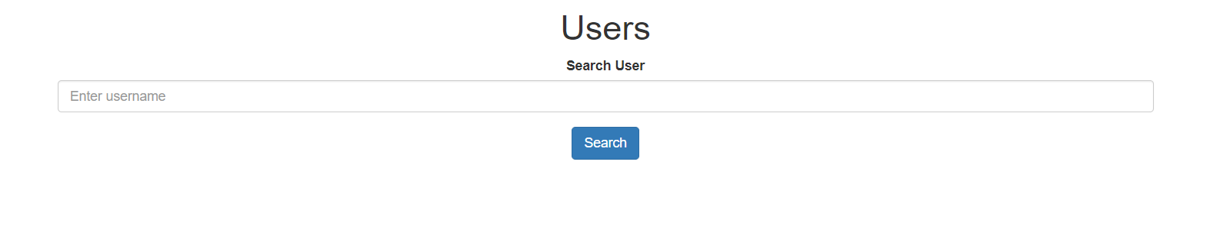
Users Page
Click “Users” button on home page.
Should navigate to http://localhost:3000/html/users.html
From top to bottom, should see “Users” header, “Search User” bar, then “Search” button
“Search User” bar should be empty with “Enter username” placeholder.

Slide 5
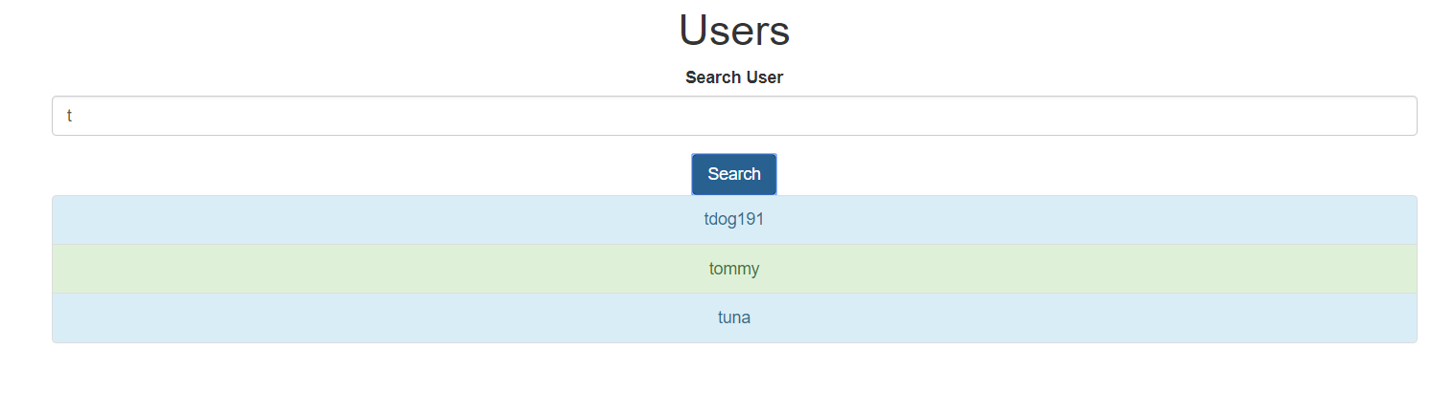
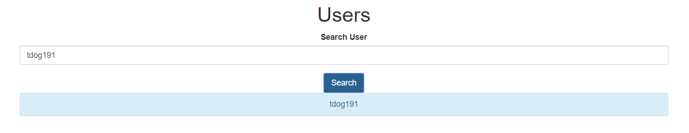
User Search
First Search
Enter “t” (or other prefix (ignoring case) of a username in the database) into search bar and click “Search” button.
Should see list of all usernames in database with matching prefixes (ignoring case)
Odd-numbered entries should be colored light-blue while even-numbered entries are colored light-green.
Enter “tdog191” (or other username in database) into search bar and click “Search” button.
Old search results should disappear, and the new search results should be displayed.
Second Search

Slide 6
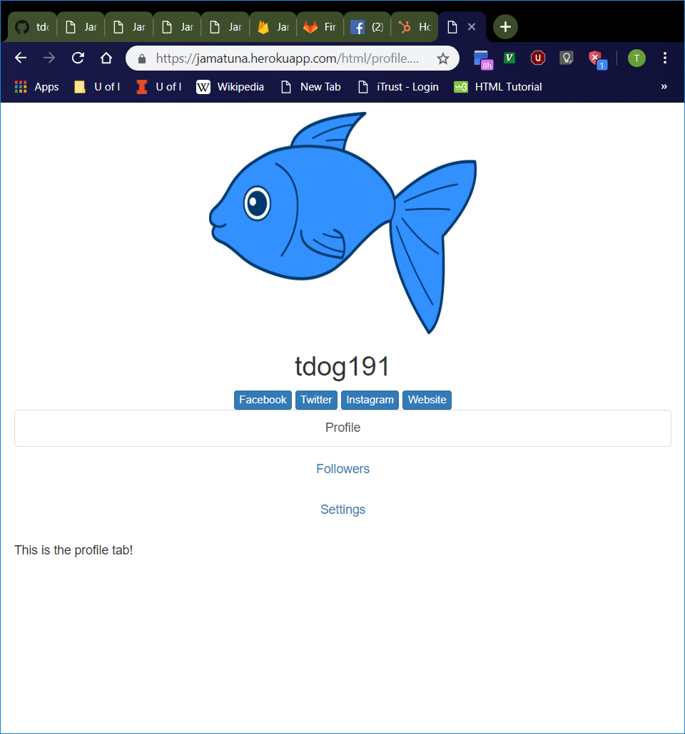
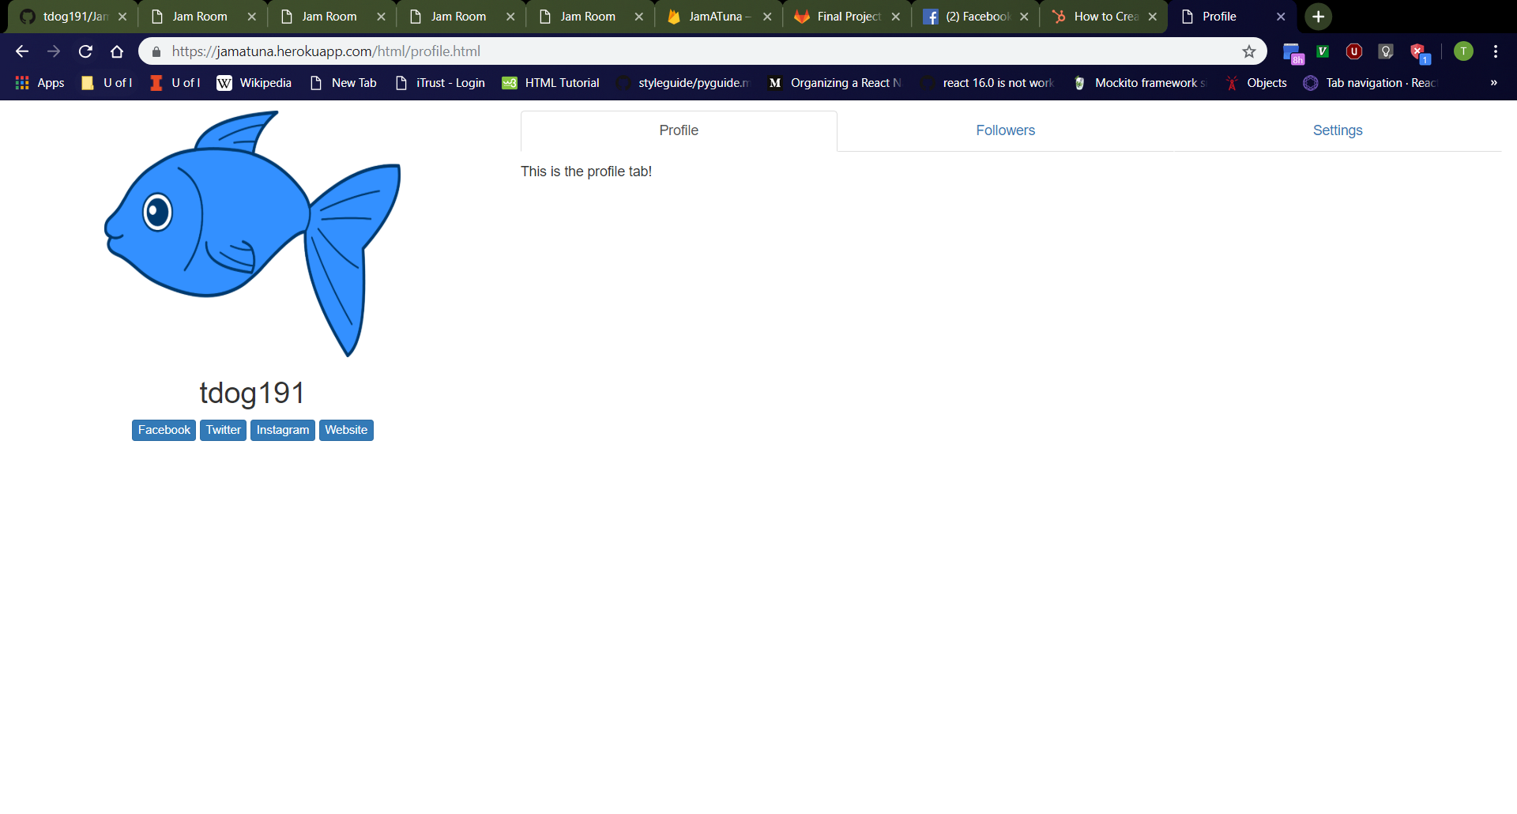
Profile Page
Vertical Window
Click “tdog191” (or other search result entry on “Users” page).
Should navigate to http://localhost:3000/html/profile.html
Should see profile page with “Profile”, “Followers”, and “Settings” tabs
Should see user’s profile picture with user’s username underneath
Tabs should be clickable.
Profile page should adjust layout depending on screen orientation.
Full-Sized Window

Slide 7

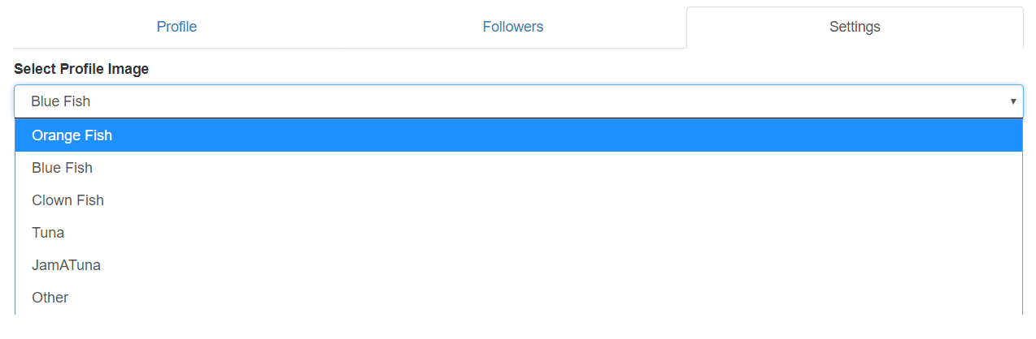
Settings Tab
Settings Tab
Click “Settings” tab on “Profile” page.
Should see dropdown menu with label “Select Profile Image”
Dropdown menu should have image corresponding to profile picture selected by default (“Blue Fish” in examples on this slide).
Dropdown menu should have “Orange Fish”, “Blue Fish”, “Clown Fish”, “Tuna”, “JamATuna”, and “Other” options.
Dropdown Menu

Slide 8
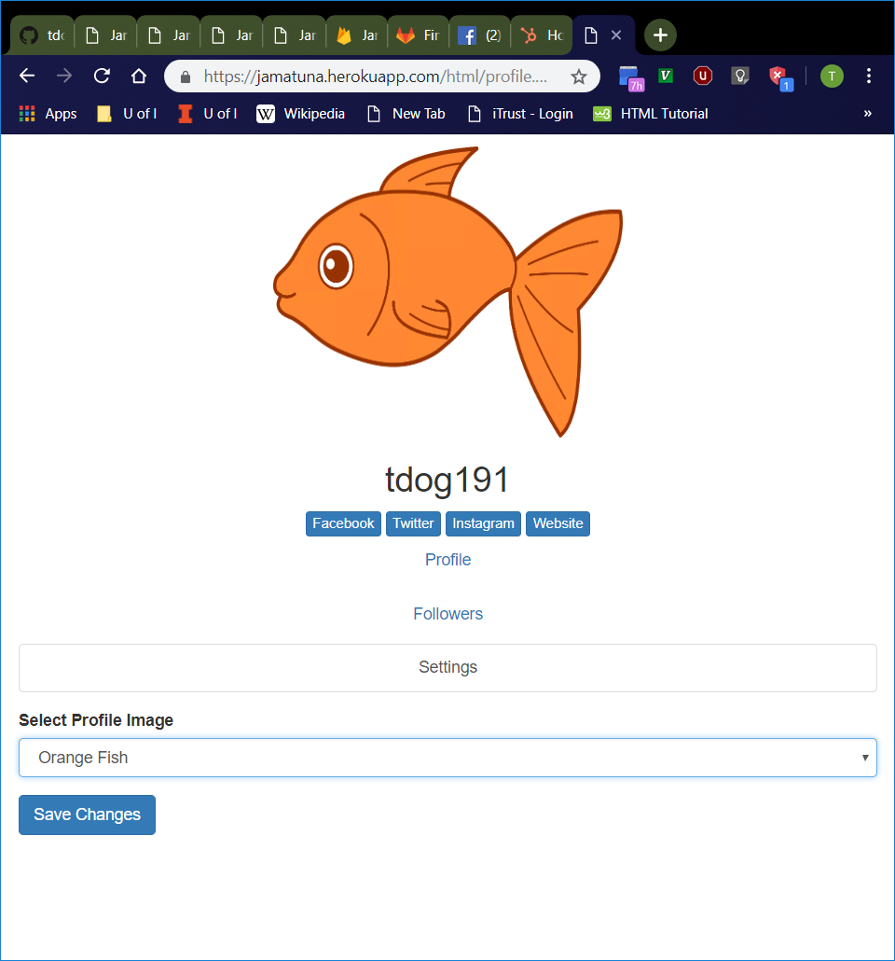
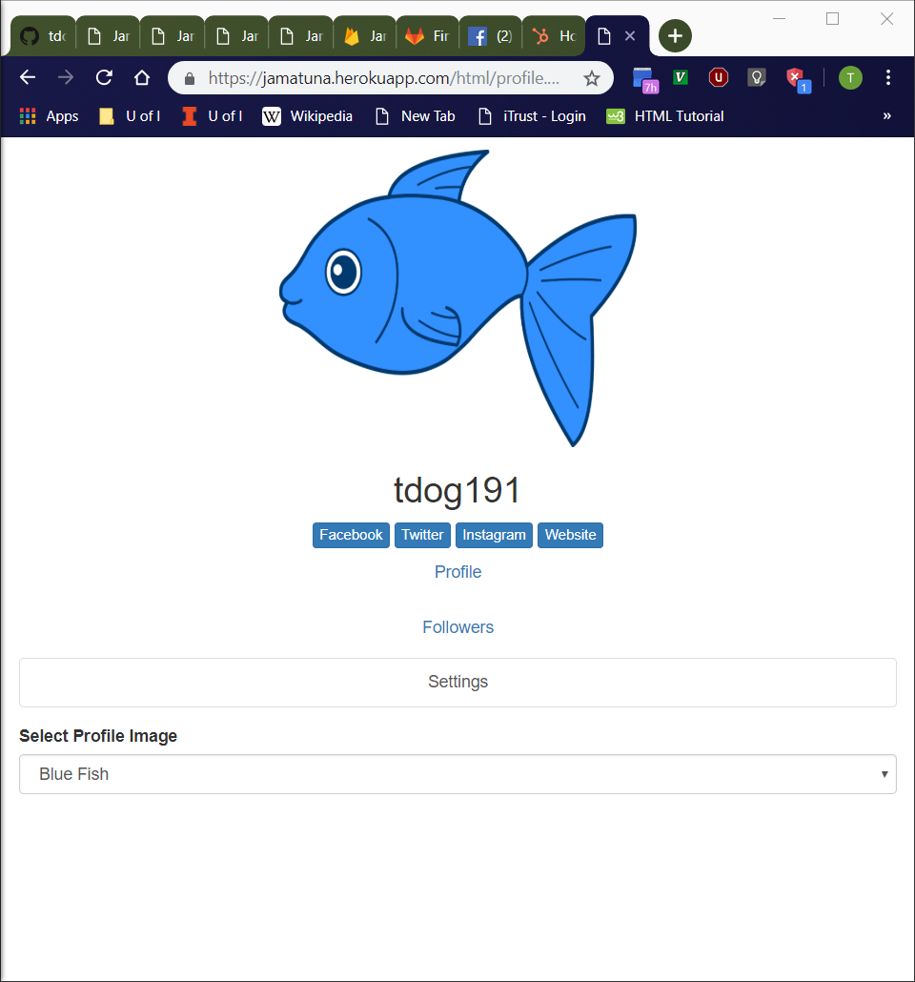
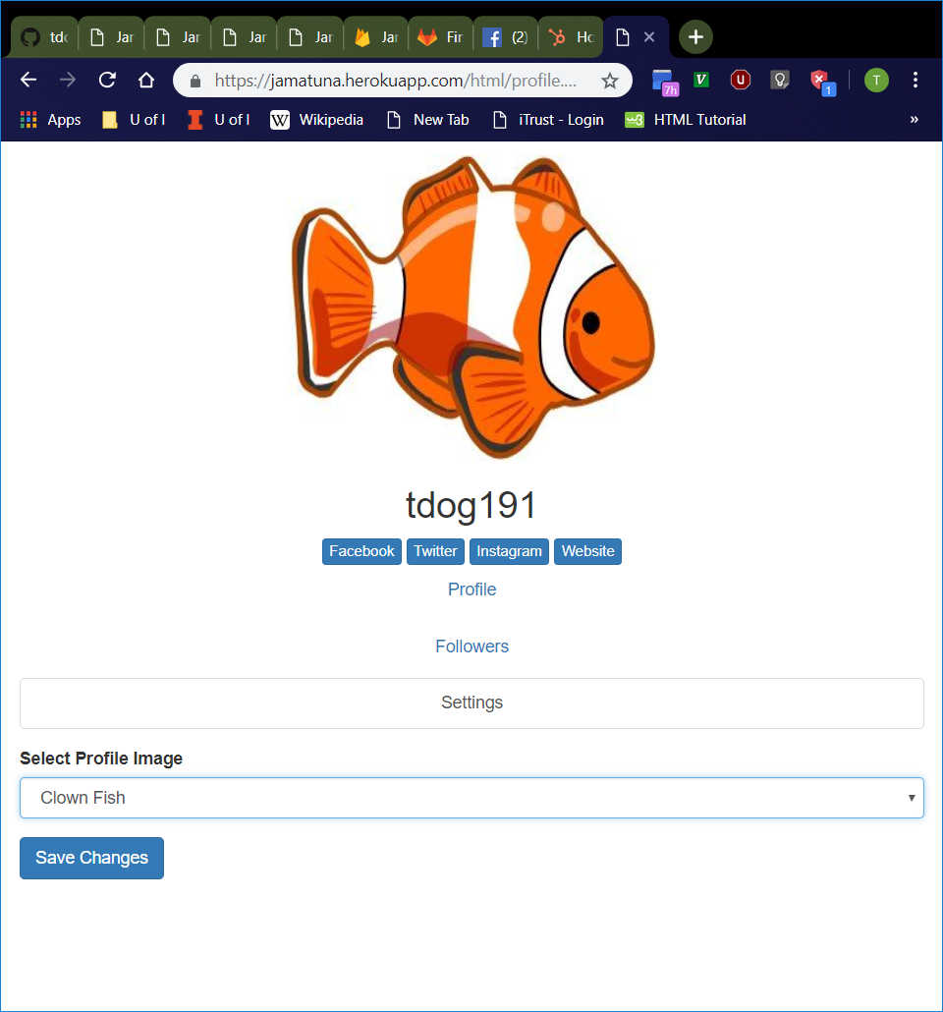
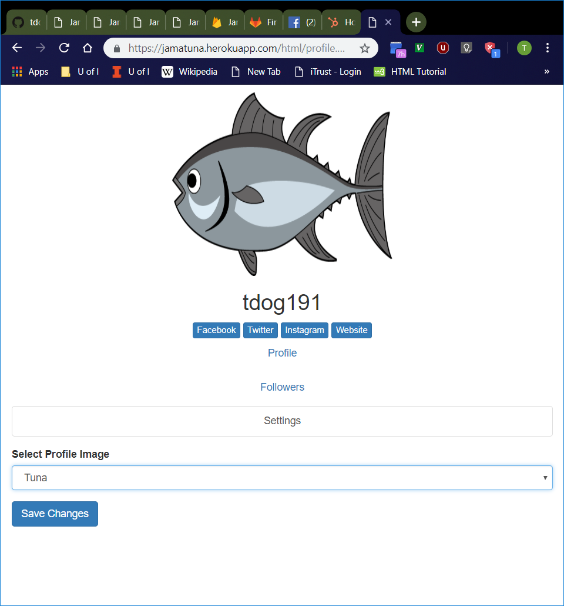
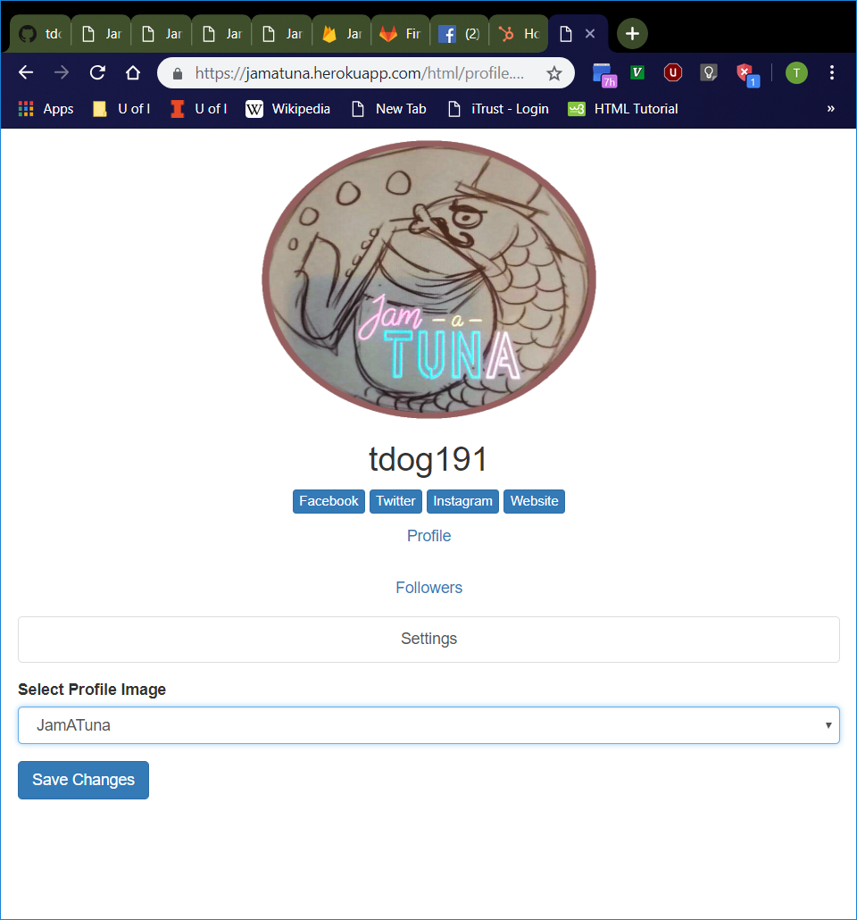
Available Profile Pictures
Select every option in the “Settings” tab dropdown menu, one-by-one except “Other”.
Profile picture should be updated with the appropriate picture.
If selected option is different from the picture that initially displayed upon loading the profile page, a “Save Changes” button should appear.
If selecting the initial picture after selecting a different picture, the “Save Changes” button should disappear.
Orange Fish
Blue Fish
Clown Fish
Tuna
JamATuna

Slide 9
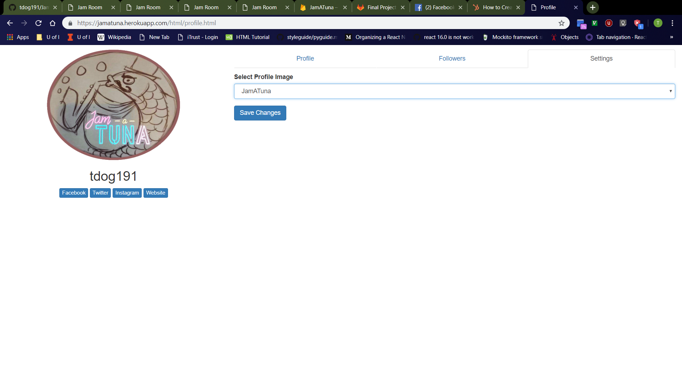
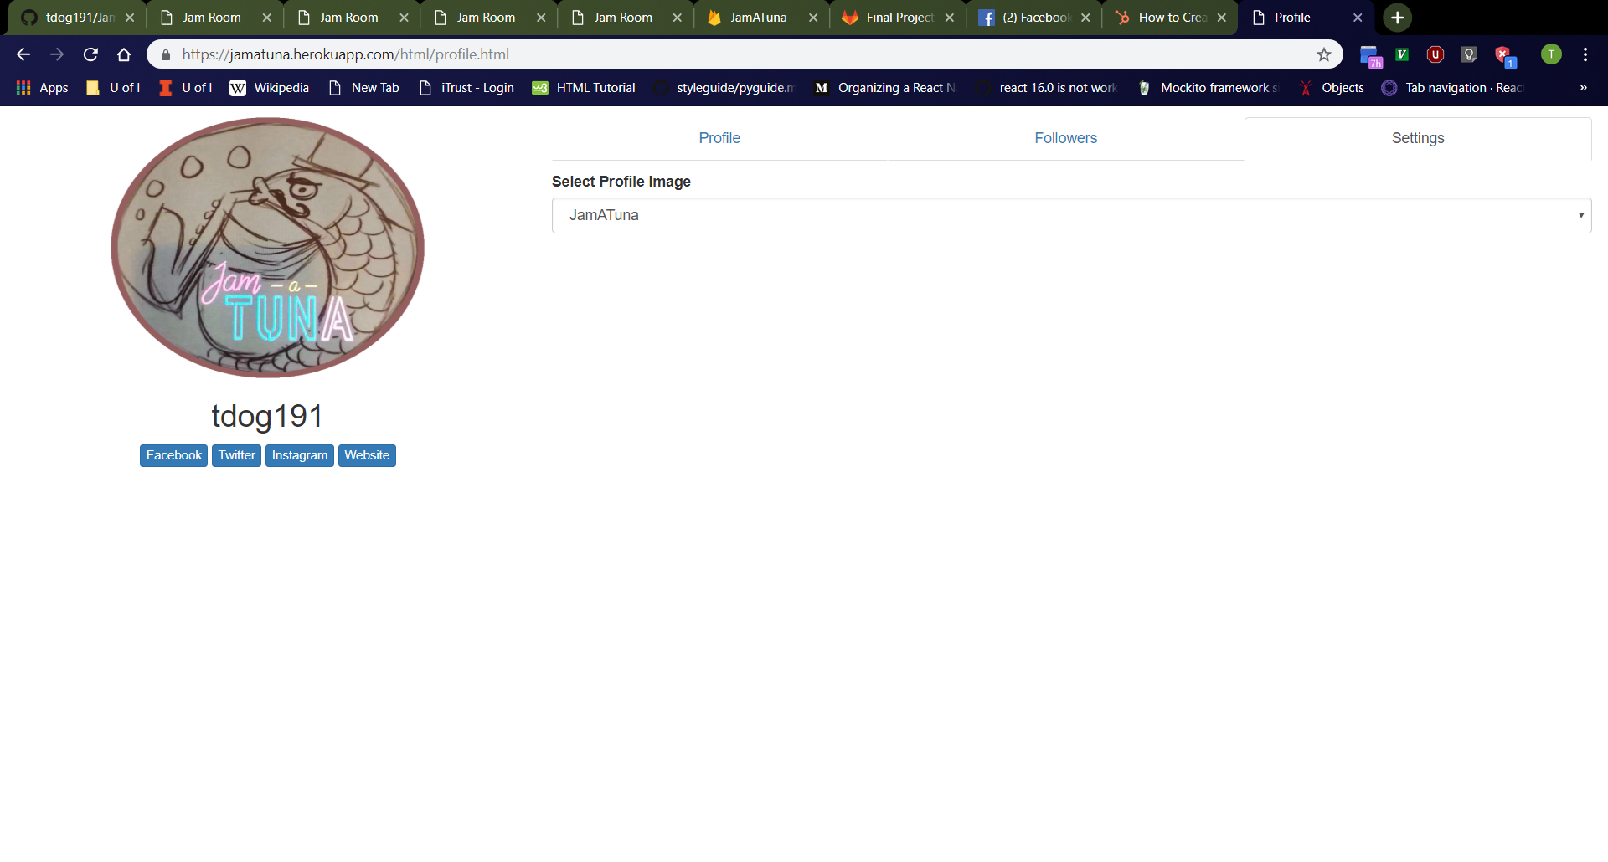
“Save Changes” Button
Before Clicking Button
Select “JamATuna” (or other option different from profile picture initially loaded onto page) then click “Save Changes” button.
Page should refresh with selected picture.
The “Select Profile Image” bar in the “Settings” tab should default to the selected image.
The “Save Changes” button should disappear.
After Clicking Button

Slide 10
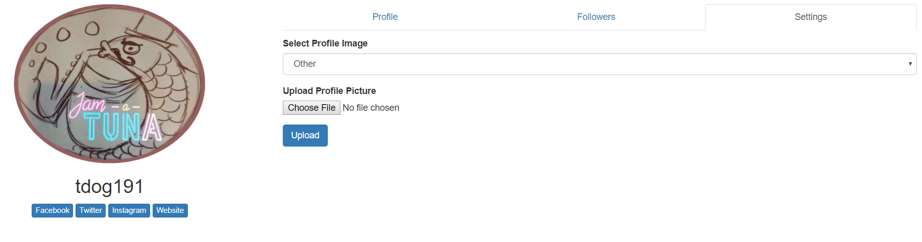
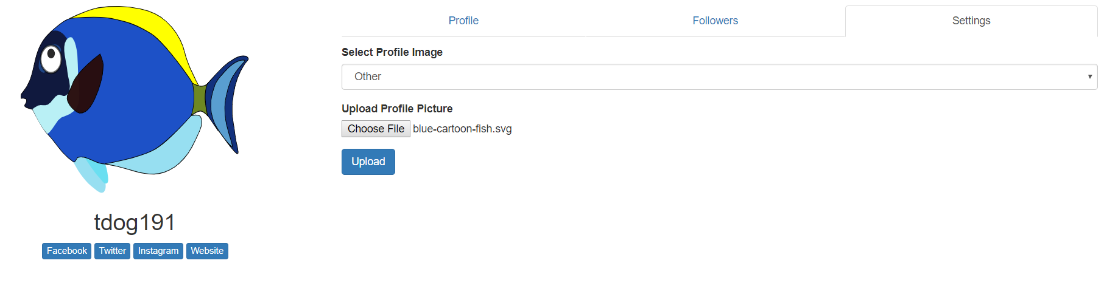
Uploading Profile Pictures
“Upload Profile Picture” Option
Select “Other” from dropdown menu in “Settings tab.
File upload button with “Upload Profile Picture” label and “Upload” button should now appear, and they should disappear after selecting a different option from dropdown menu.
File upload button should bring up File Explorer or similar file upload window
Selecting a file should immediately update the profile picture with the image file.
Select “blue-cartoon-fish.svg” file (or other image file), then click “Upload” button.
Page should refresh with selected picture.
The “Select Profile Image” bar in the “Settings” tab should default to “Other”.
After Selecting Image File

Slide 11
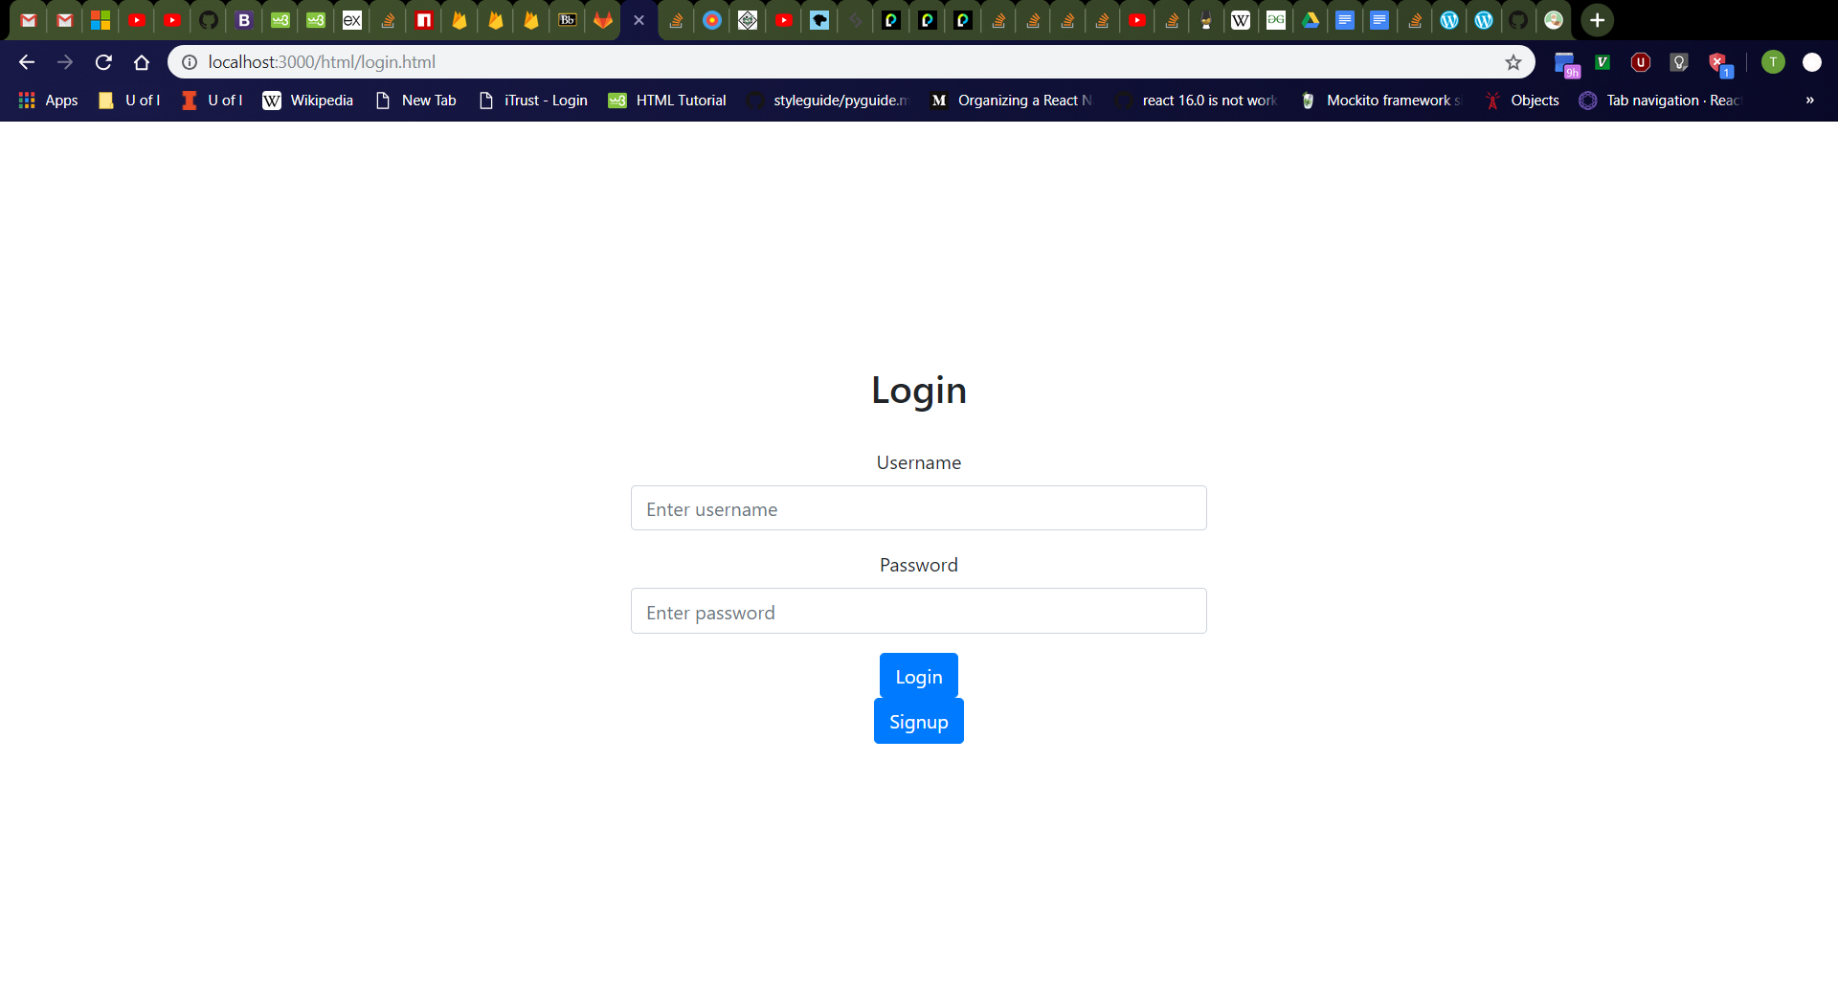
Login Page
Click “Login” button on home page.
Should navigate to http://localhost:3000/html/login.html
From top to bottom, should see “Login” header, username box with label, password box with label, “Login” button, then “Signup” button
Username box should be empty with “Enter username” placeholder.
Password box should be empty with “Enter password” placeholder.

Slide 12
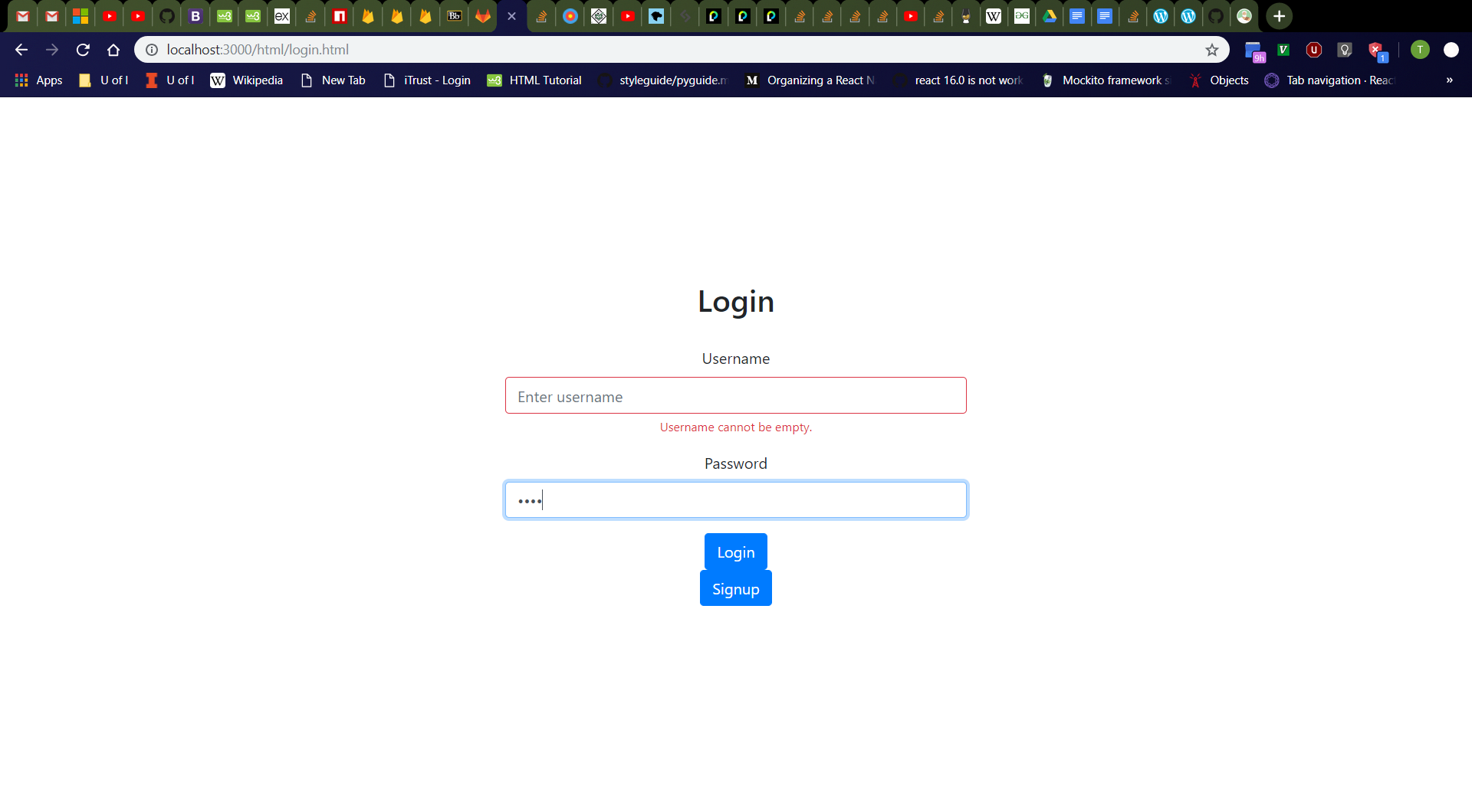
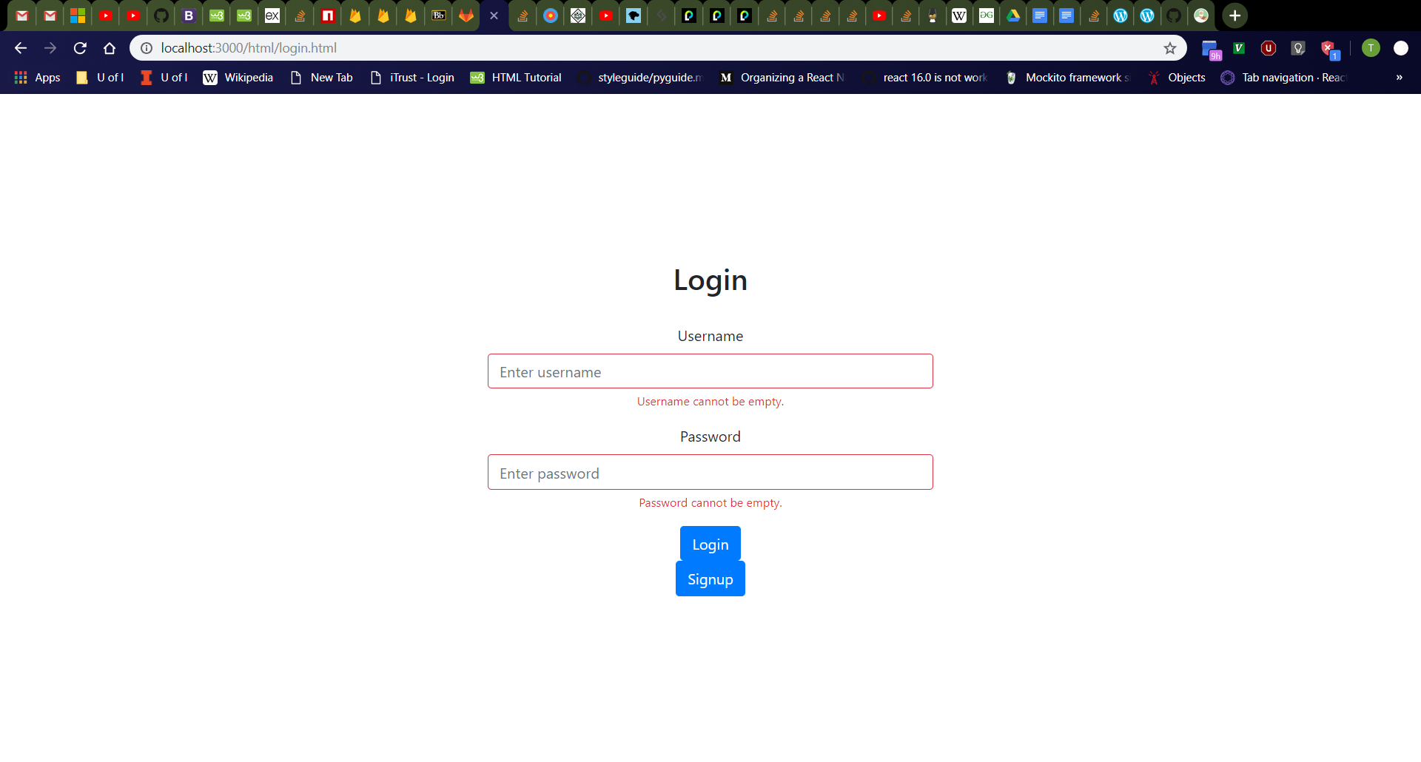
Login Page Error Messages
Click username box, then password box, then click away.
Should see username and password boxes turn red with red “Username cannot be empty.” and “Password cannot be empty.” messages respectively
Refresh the page then click the “Login” button
Should see red error messages again
Validation checks for empty username and password should always occur as user releases keyboard keys, the boxes lose focus, and when the “Login” button is clicked.
Empty Username
Empty Username and Password

Slide 13
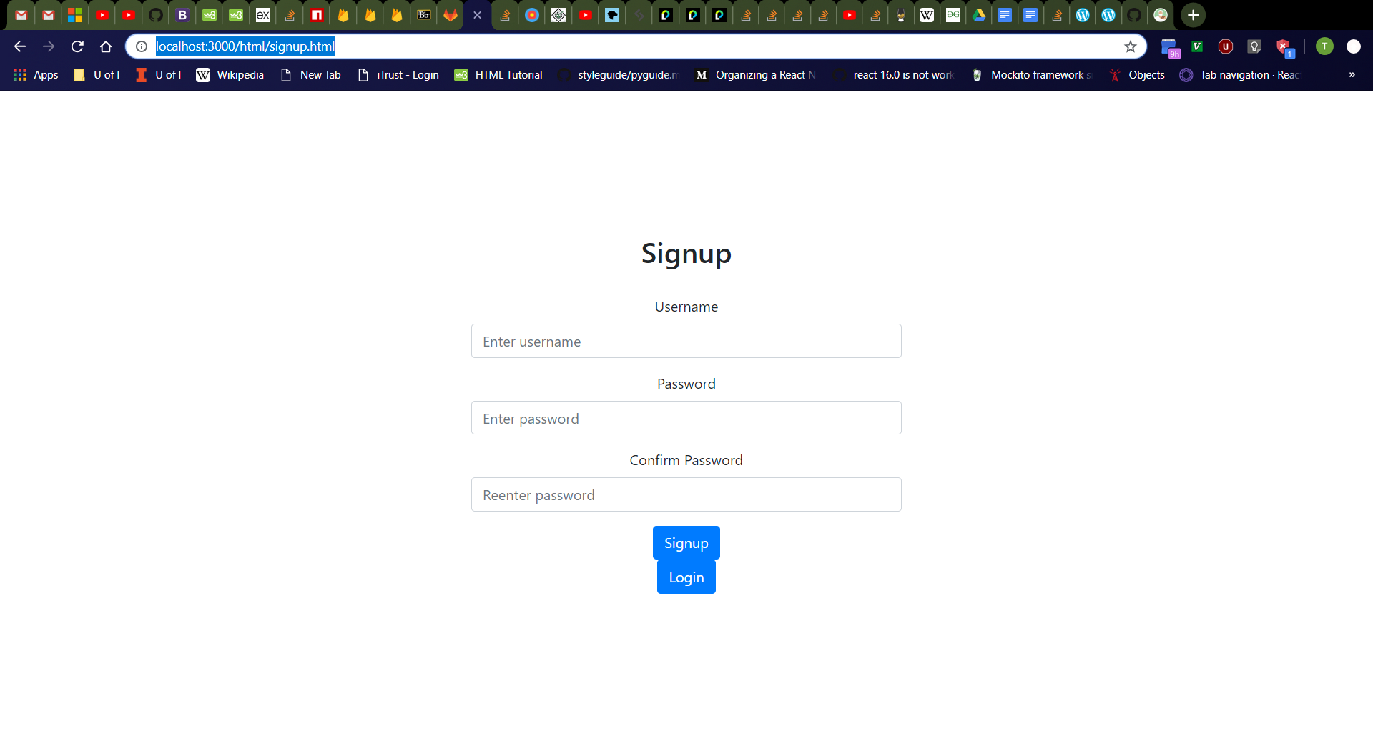
Signup Page
Click “Signup” button on login page.
Should navigate to http://localhost:3000/html/signup.html
From top to bottom, should see “Signup” header, username box with label, password box with label, “Confirm Password” box with label, “Signup” button, then “Login” button
Username box should be empty with “Enter username” placeholder.
Password box should be empty with “Enter password” placeholder.
“Confirm Password” box should be empty with “Reenter password” placeholder.

Slide 14
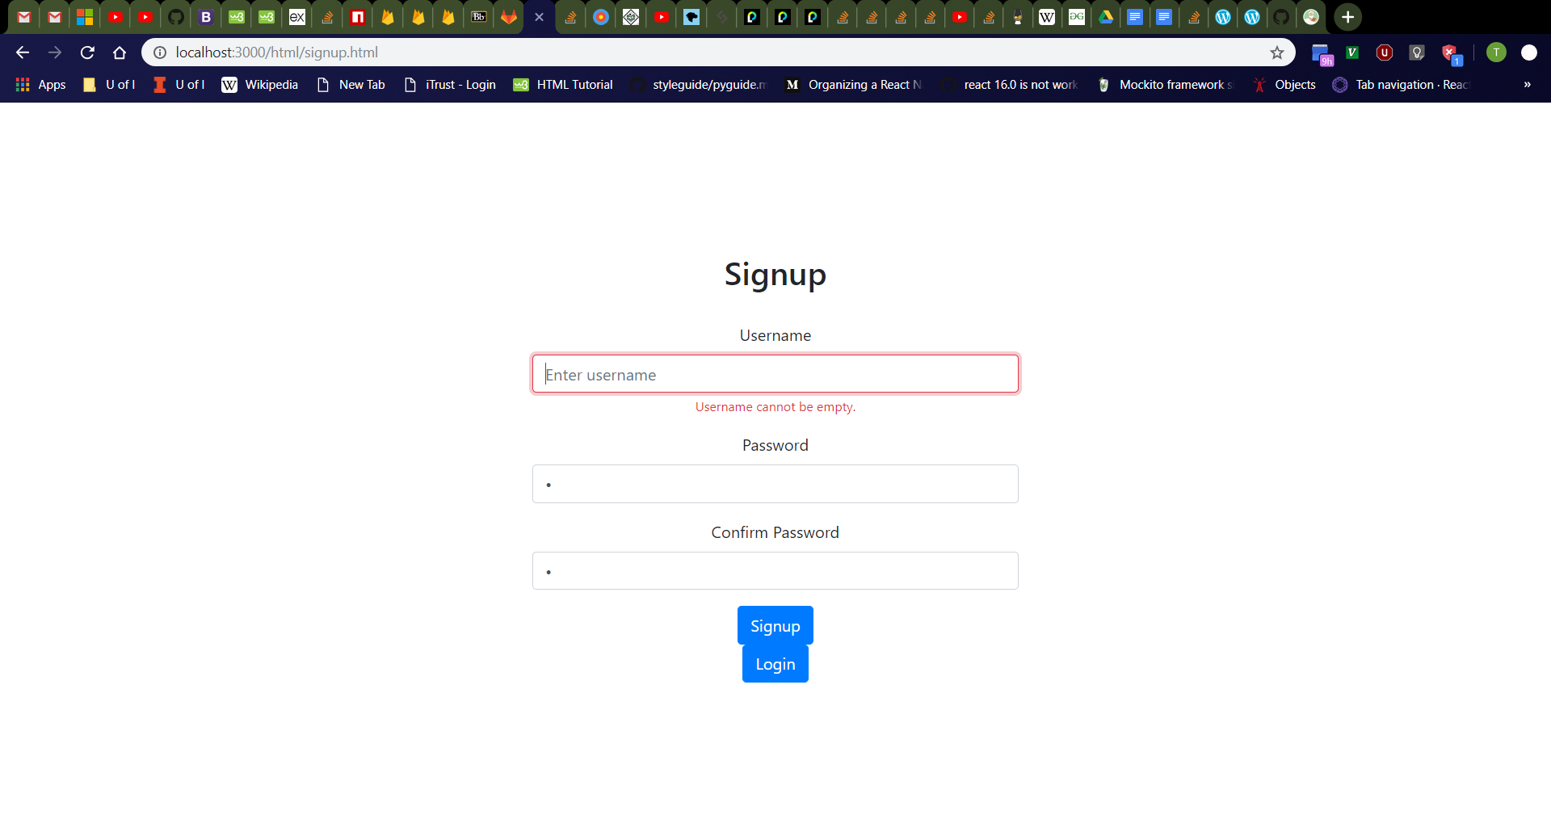
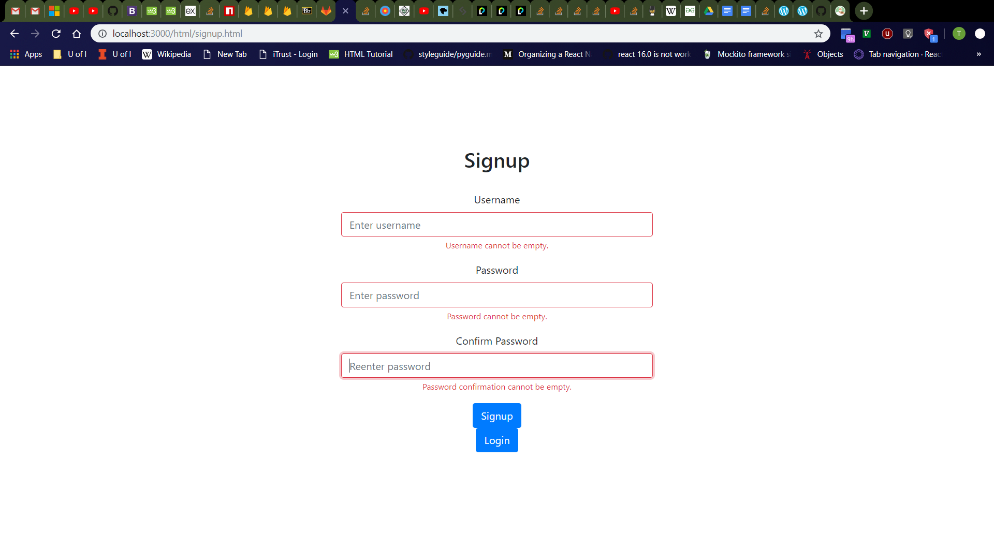
Signup Page Error Messages
Click username box, then password box, then password confirmation box, then click away.
Should see username, password, and password confirmation boxes turn red with red “Username cannot be empty.”, “Password cannot be empty.”, and “Password confirmation cannot be empty.” messages respectively
Refresh the page then click the “Signup” button
Should see red error messages again
Validation checks for empty username, password, and password confirmation should always occur as user releases keyboard keys, the boxes lose focus, and when the “Signup” button is clicked.
Empty Username and Identical Password and Password Confirmation
All boxes empty

Slide 15
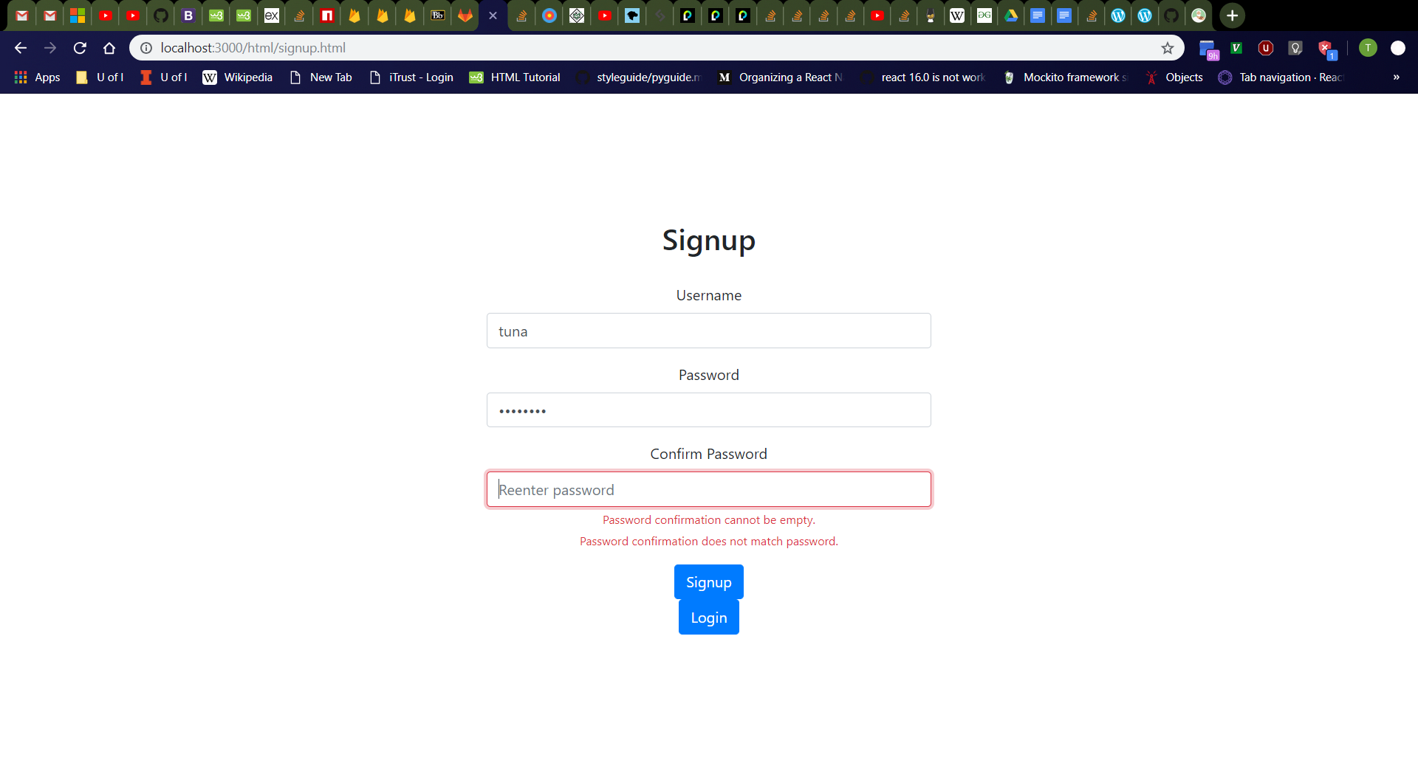

Signup Page Error Messages Cont.
Type “tuna” in username, “password” in password, and click password confirmation box.
Should see password confirmation box turn red with red “Password confirmation cannot be empty.” and “Password confirmation does not match password.” messages below
Type “password2” in password confirmation box
Should still see red “Password confirmation does not match password.” message
Password and Empty Password Confirmation
Unidentical Passwords

Slide 16
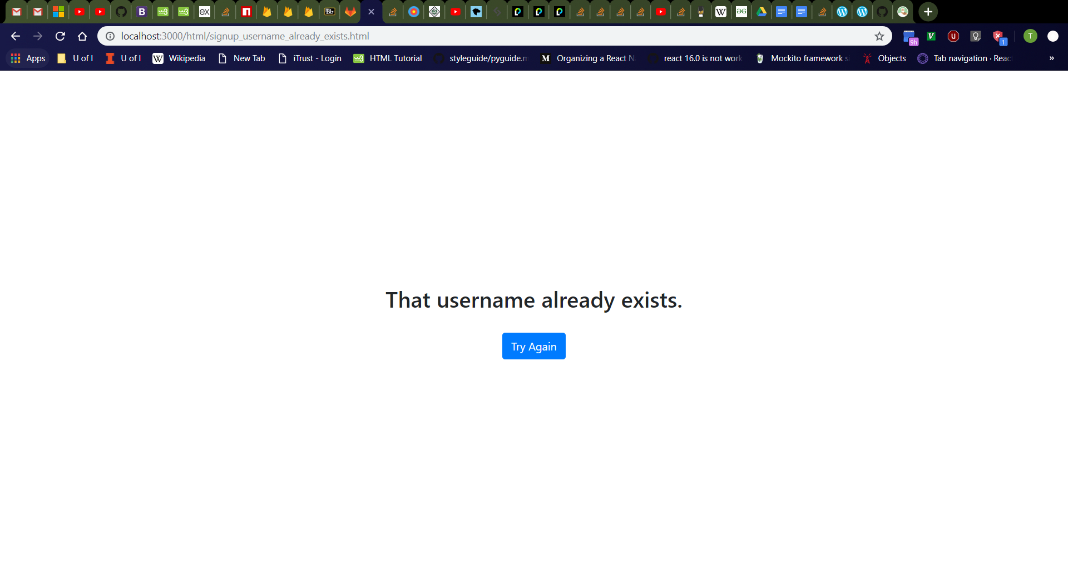
Signup Page (Username Already Exists)
Enter the following values in the signup page:
Username: “tdog191” (or other existing username in database)
Password: “password”
Confirm Password: “password”
Should see new page with message “That username already exists.” and “Try Again” button.

Slide 17
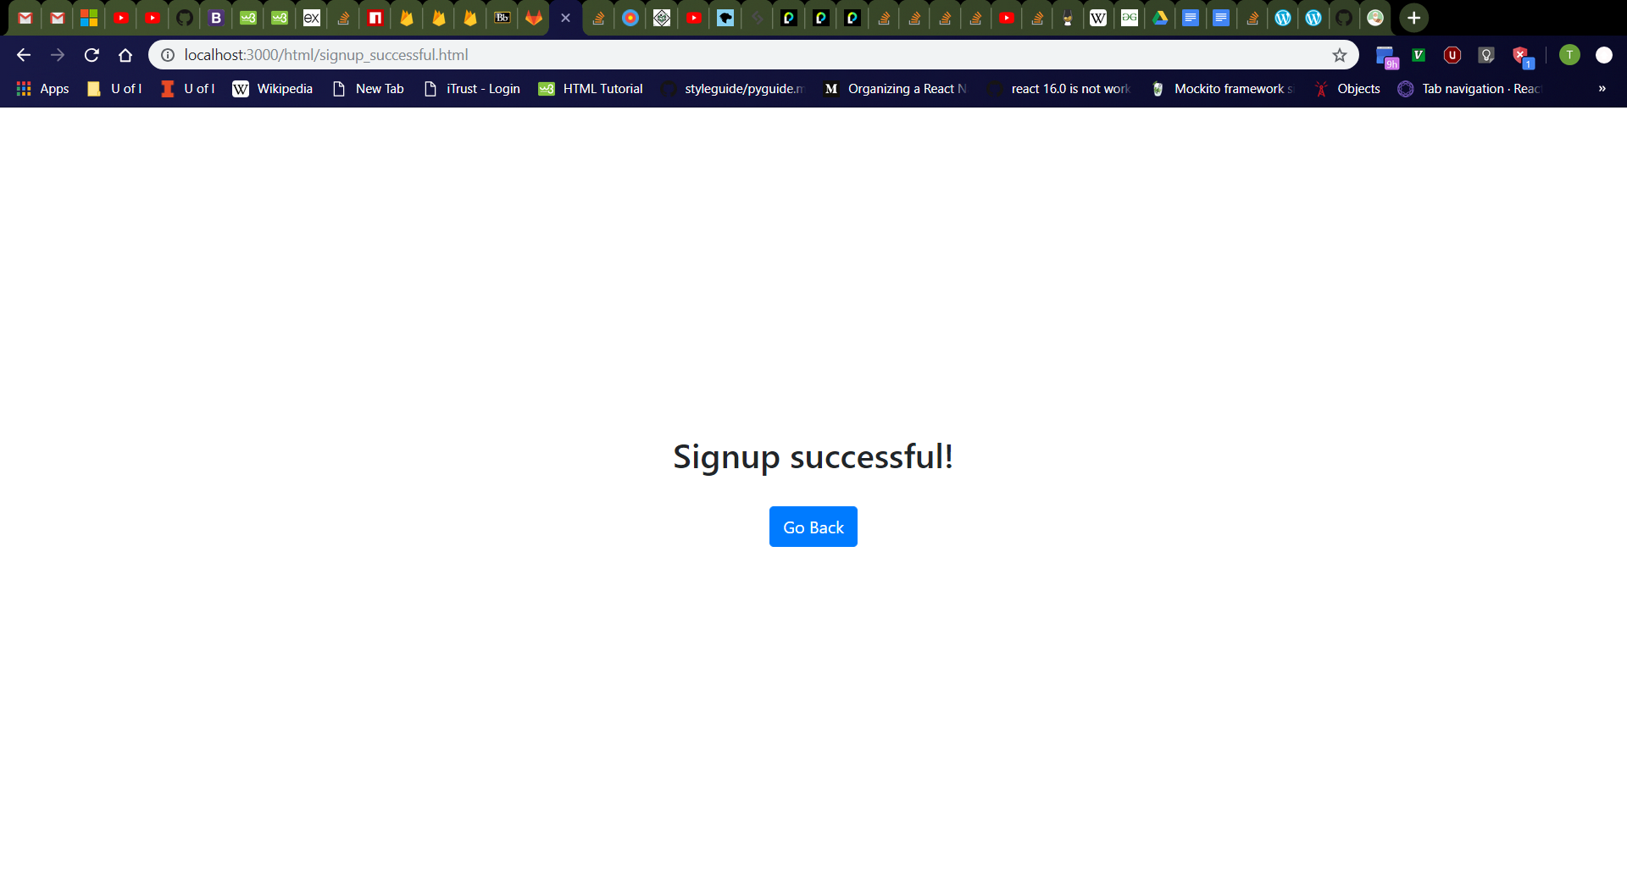
Signup Page (Success)
Click “Try Again” button
Should navigate to http://localhost:3000/html/signup.html
Enter the following values in the signup page:
Username: “tuna” (or other nonexistent username in database)
Password: “password”
Confirm Password: “password”
Should see new page with message “Signup successful!” and “Go Back” button.

Slide 18
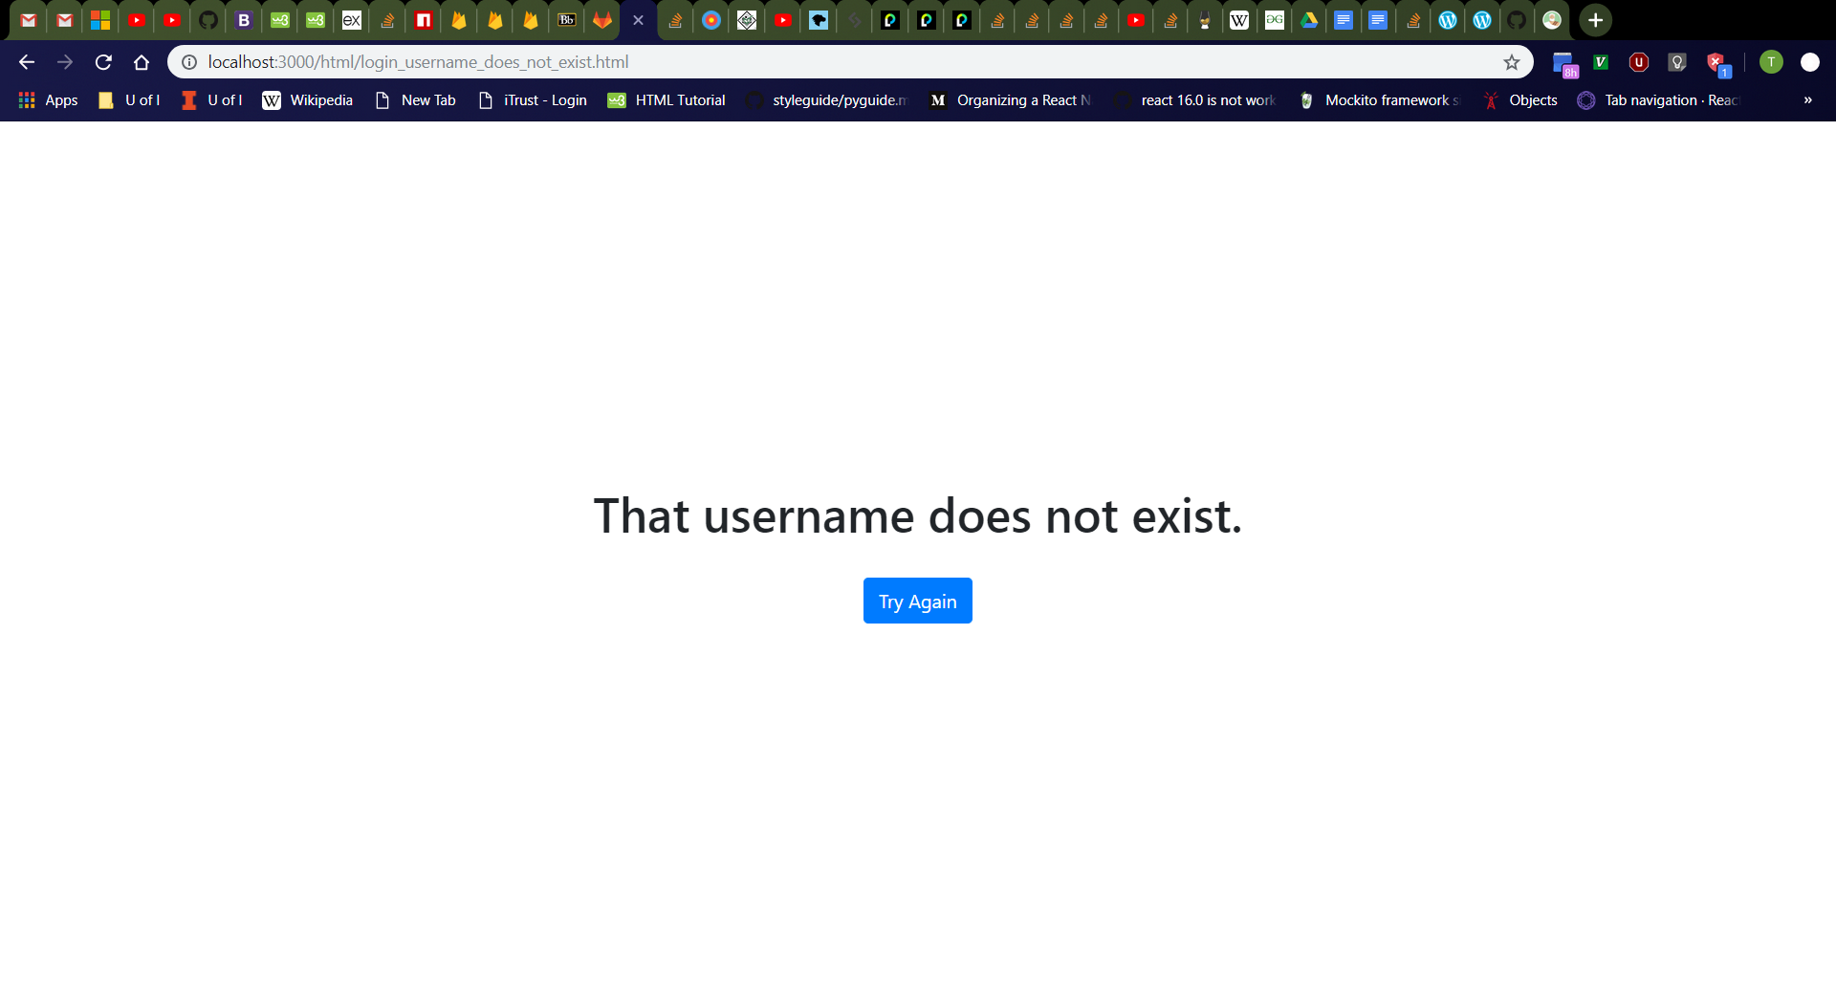
Login Page (Username Does Not Exist)
Click “Go Back” button then “Login” button
Should navigate to http://localhost:3000/html/signup.html then http://localhost:3000/html/login.html
Enter the following values in the login page:
Username: “tuna2” (or other nonexistent username in database)
Password: “password”
Should see new page with message “That username does not exist.” and “Try Again” button.

Slide 19

Login Page (Incorrect Password)
Click “Try Again” button
Should navigate to http://localhost:3000/html/login.html
Enter the following values in the login page:
Username: “tuna” (or other existing username in database)
Password: “password2” (or other incorrect password)
Should see new page with message “That password is incorrect.” and “Try Again” button.

Slide 20
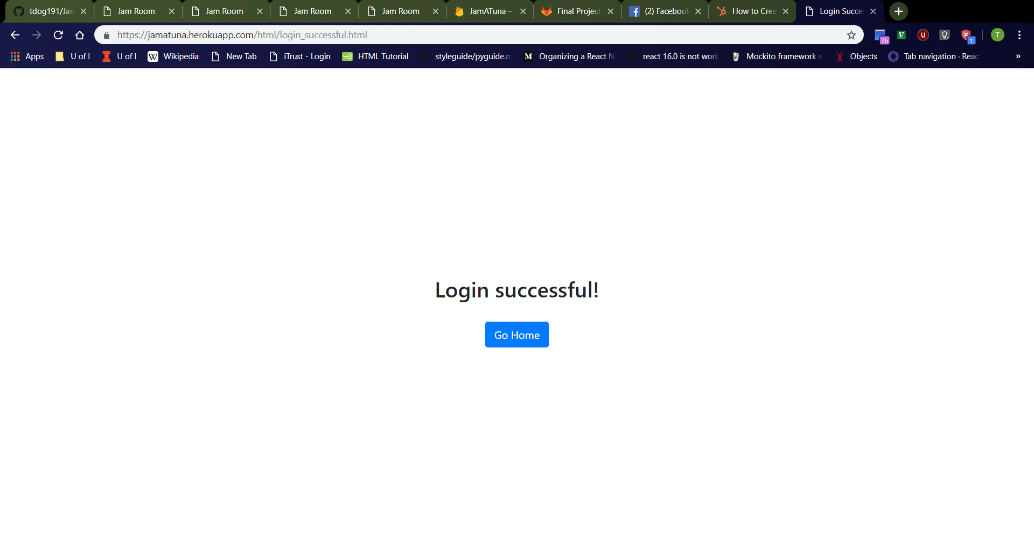
Login Page (Success)
Click “Try Again” button
Should navigate to http://localhost:3000/html/login.html
Enter the following values in the login page:
Username: “tuna” (or other existing username in database)
Password: “password” (or which password is correct)
Should see new page with message “Login successful!” and “Go Home” button.

Slide 21
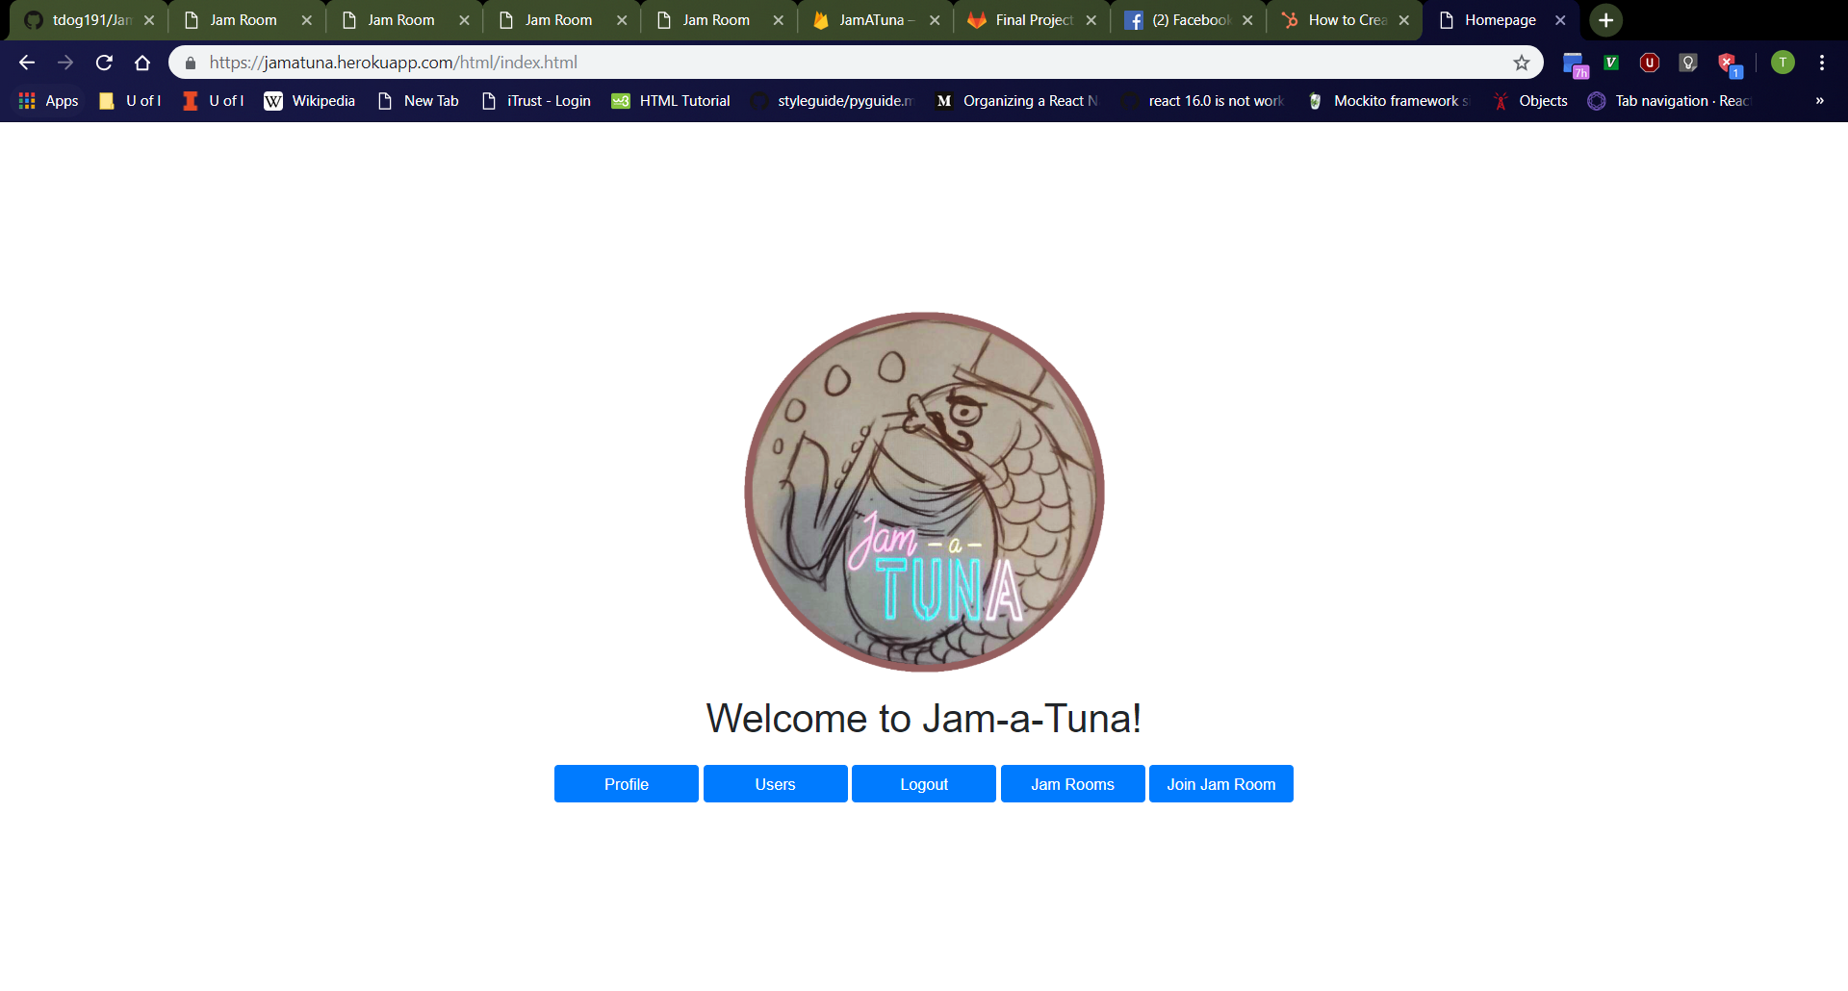
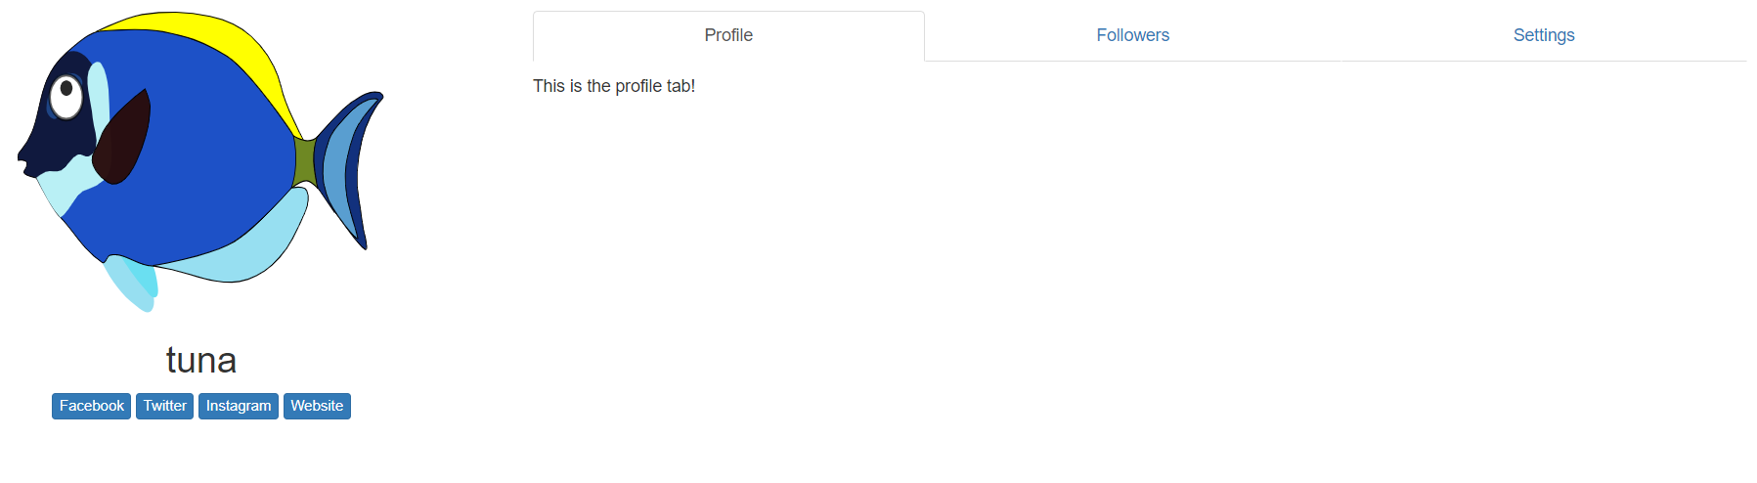
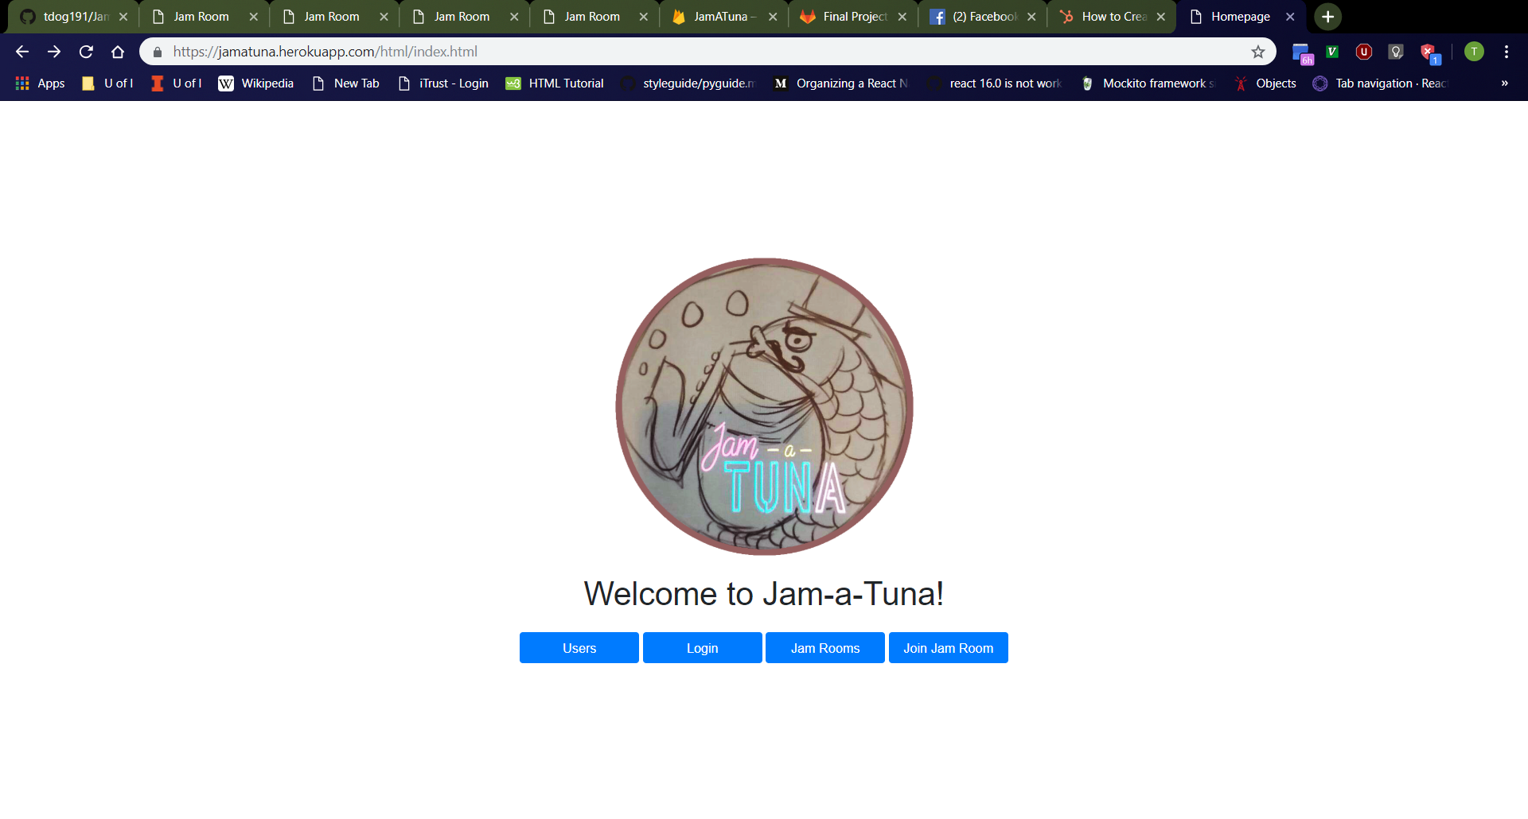
Home Page (After Login)
New Home Page
Click “Go Home” button
Should navigate to http://localhost:3000/html/index.html
Should see JamATuna homepage from before, now with a “Profile” and “Logout” buttons and no “Login” button because a login happened
Click on “Profile” button
Should navigate to profile page of logged-in user (“tuna” in example to the right)
Click on “Logout” button
Should refresh to display old home page
Profile Page of Logged-In User
Old Home Page

Slide 22
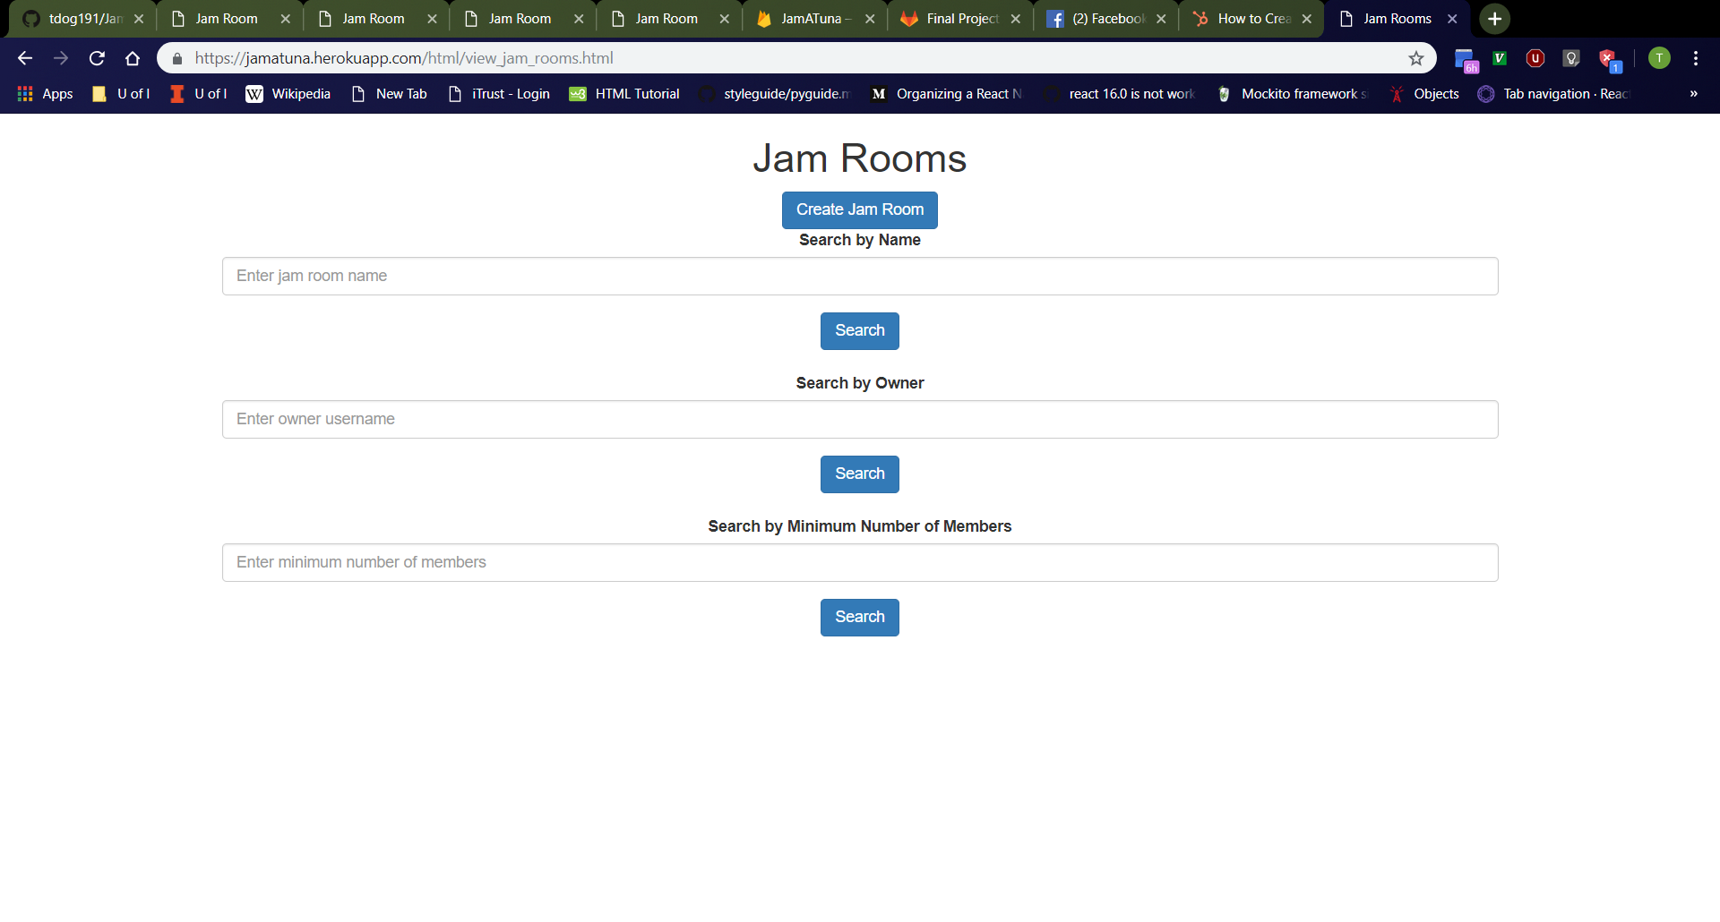
Jam Rooms Page
Click “Jam Rooms” button on home page.
Should navigate to http://localhost:3000/html/view_jam_rooms.html
From top to bottom, should see “Jam Rooms” header, “Create Jam Room” button, “Search by Name” bar, “Search” button, “Search by Owner” bar, “Search” button, “Search by Minimum Number of Members” bar, then “Search” button
“Search by Name” bar should be empty with “Enter jam room name” placeholder.
“Search by Owner” bar should be empty with “Enter owner username” placeholder.
“Search by Minimum Number of Members” bar should be empty with “Enter minimum number of members” placeholder.

Slide 23

Create Jam Room Page
Click “Create Jam Room” button on “Jam Rooms” page.
Should navigate to http://localhost:3000/html/create_jam_room.html
From top to bottom, should see “Create Jam Room” header, jam room name box with label, owner username box with label, then “Create” button
Jam room name box should be empty with “Enter name” placeholder.
Owner username box should be empty with “Enter owner username” placeholder.

Slide 24

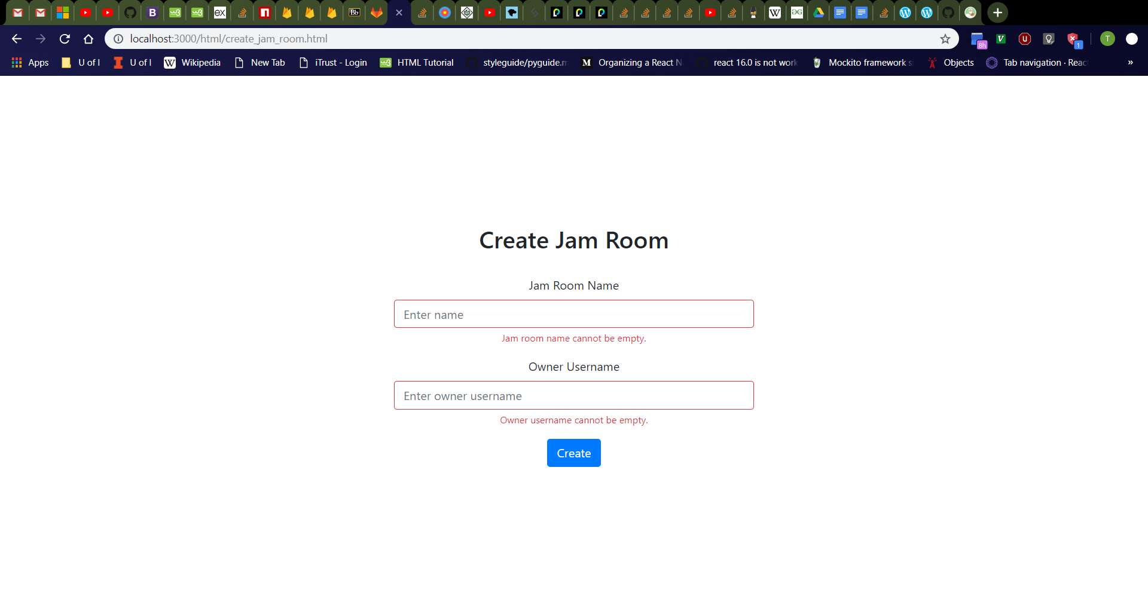
Create Jam Room Page Error Messages
Click jam room name box, then owner username box, then click away.
Should see jam room name and owner username boxes turn red with red “Jam room name cannot be empty.” and “Owner username cannot be empty.” messages respectively
Refresh the page then click the “Create” button
Should see red error messages again
Validation checks for empty jam room name and owner username boxes should always occur as user releases keyboard keys, the boxes lose focus, and when the “Create” button is clicked.
Empty Jam Room Name
All boxes empty

Slide 25

Create Jam Room Page (Jam Room Already Exists)
Enter the following values in the jam room creation page:
Jam Room Name: “More Tuna Toes” (or other existing jam room in database)
Owner Username: “tdog191”
Should see new page with message “That jam room already exists.” and “Try Again” button.

Slide 26

Create Jam Room Page (Owner Username Does Not Exist)
Click “Try Again” button
Should navigate to http://localhost:3000/html/create_jam_room.html
Enter the following values in the jam room creation page:
Jam Room Name: “Dancing Tuna Feet” (or other nonexistent jam room in database)
Owner Username: “salt” (or other nonexistent user in database)
Should see new page with message “That owner username does not exist.” and “Try Again” button.

Slide 27
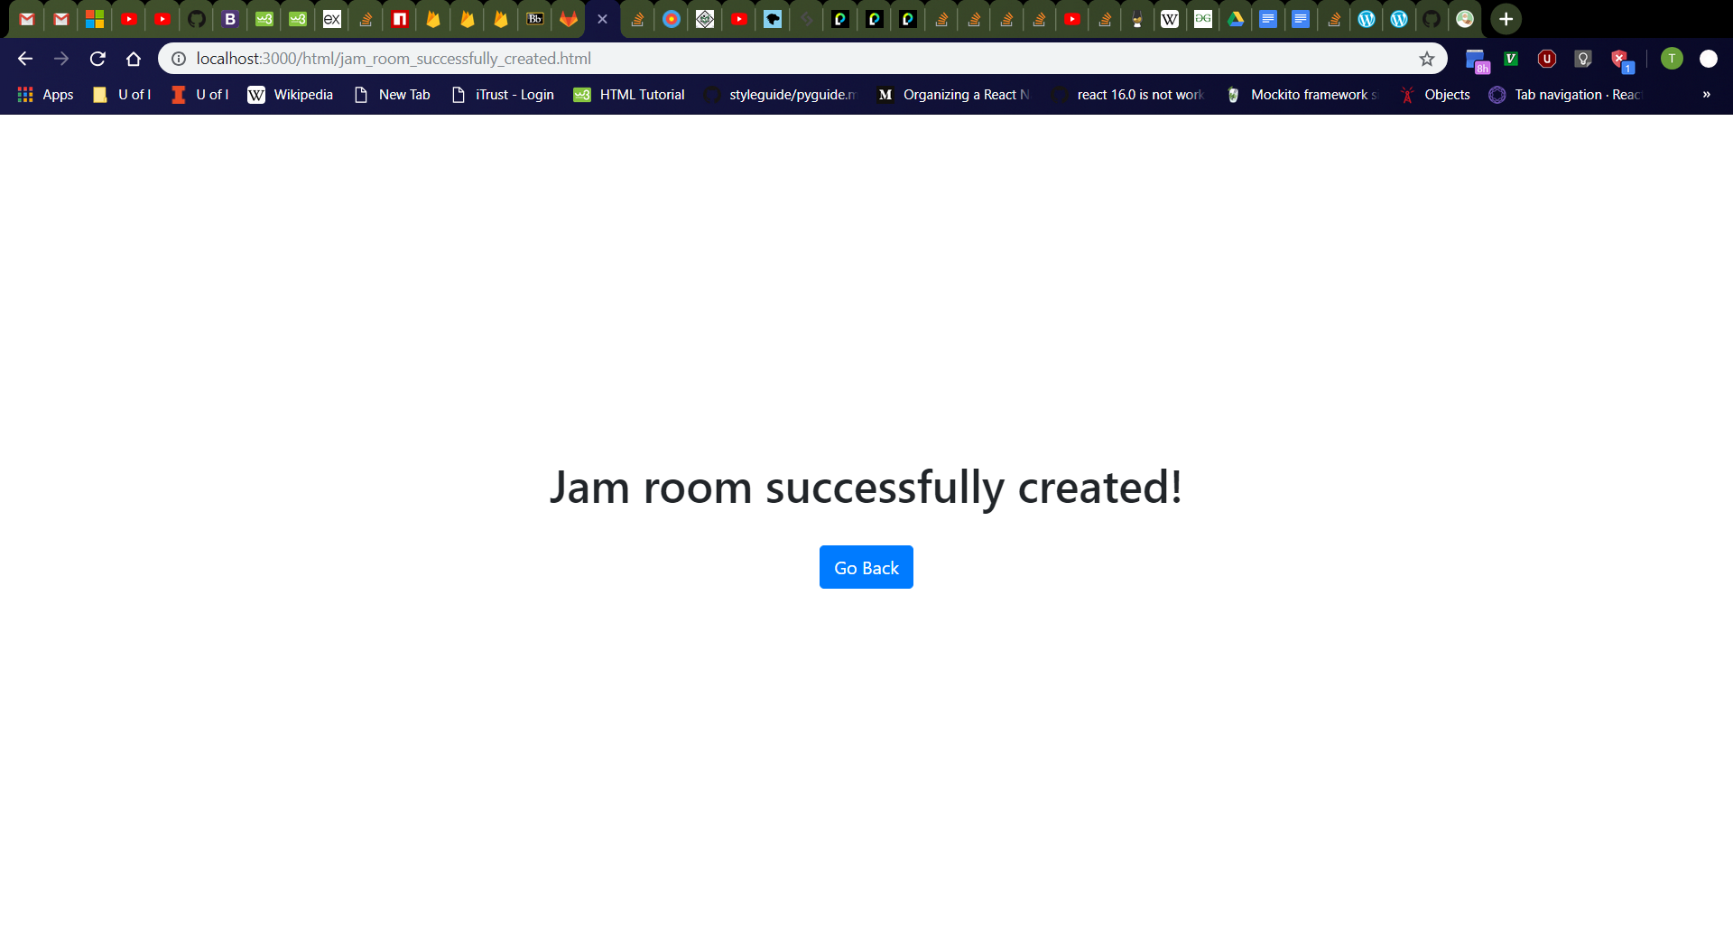
Create Jam Room Page (Success)
Click “Try Again” button
Should navigate to http://localhost:3000/html/create_jam_room.html
Enter the following values in the jam room creation page:
Jam Room Name: “Dancing Tuna Feet” (or other nonexistent jam room in database)
Owner Username: “tdog191” (or other existing user in database)
Should see new page with message “Jam room successfully created!” and “Go Back” button.

Slide 28
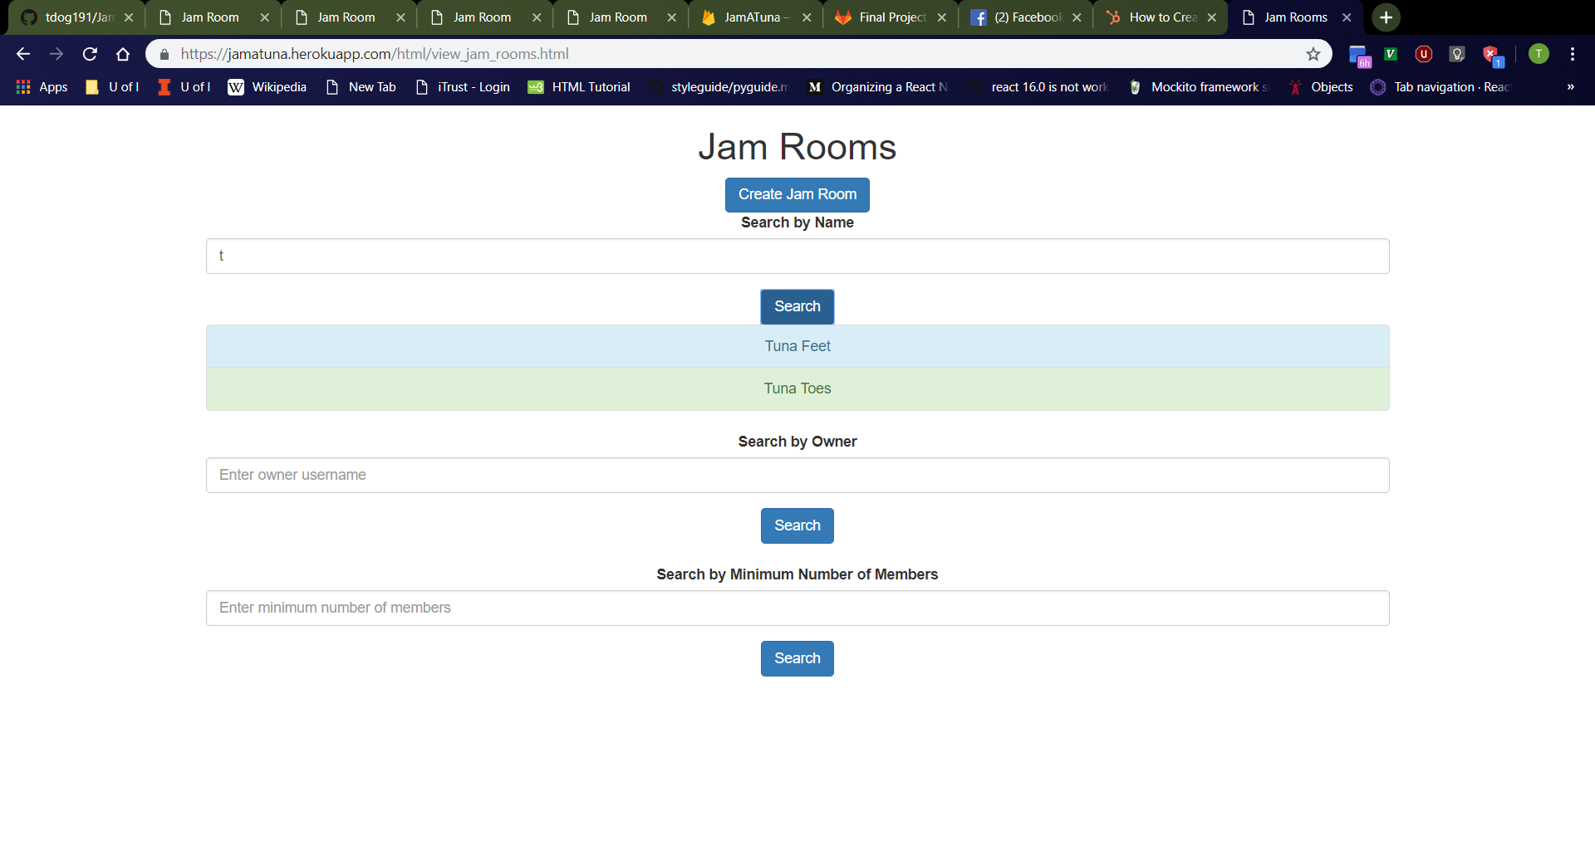
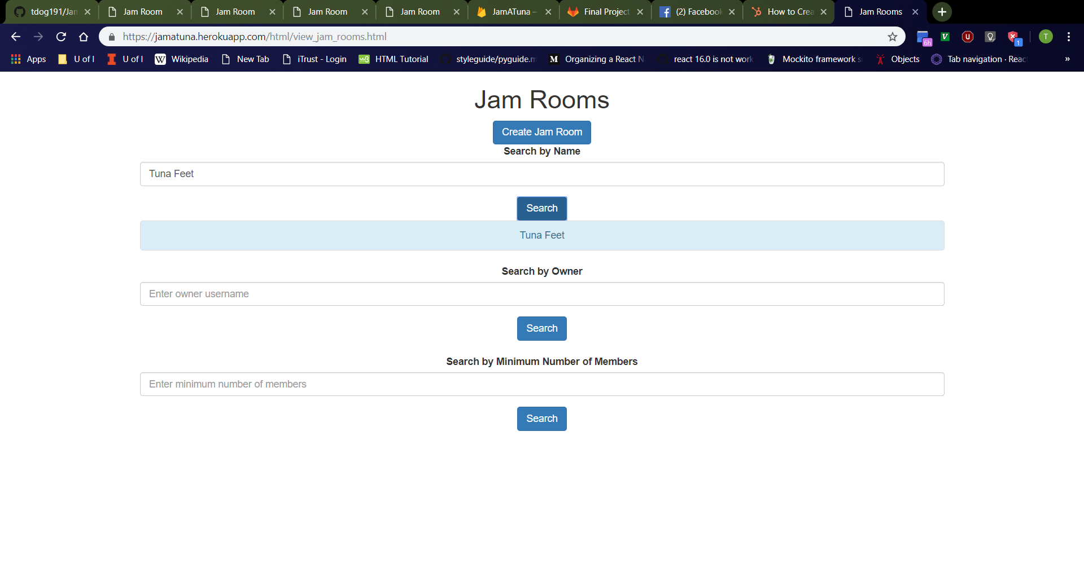
Jam Room Search (Search by Name)
First Search
Return to “Jam Rooms” page and enter “t” (or other prefix (ignoring case) of a jam room in the database) into “Search by Name” bar and click “Search” button immediately below.
Should see list of all jam rooms in database with matching prefixes (ignoring case)
Odd-numbered entries should be colored light-blue while even-numbered entries are colored light-green.
Enter “Tuna Feet” (or other jam room in database) into “Search by Name” bar and click “Search” button immediately below.
Old search results should disappear, and the new search results should be displayed.
Second Search

Slide 29
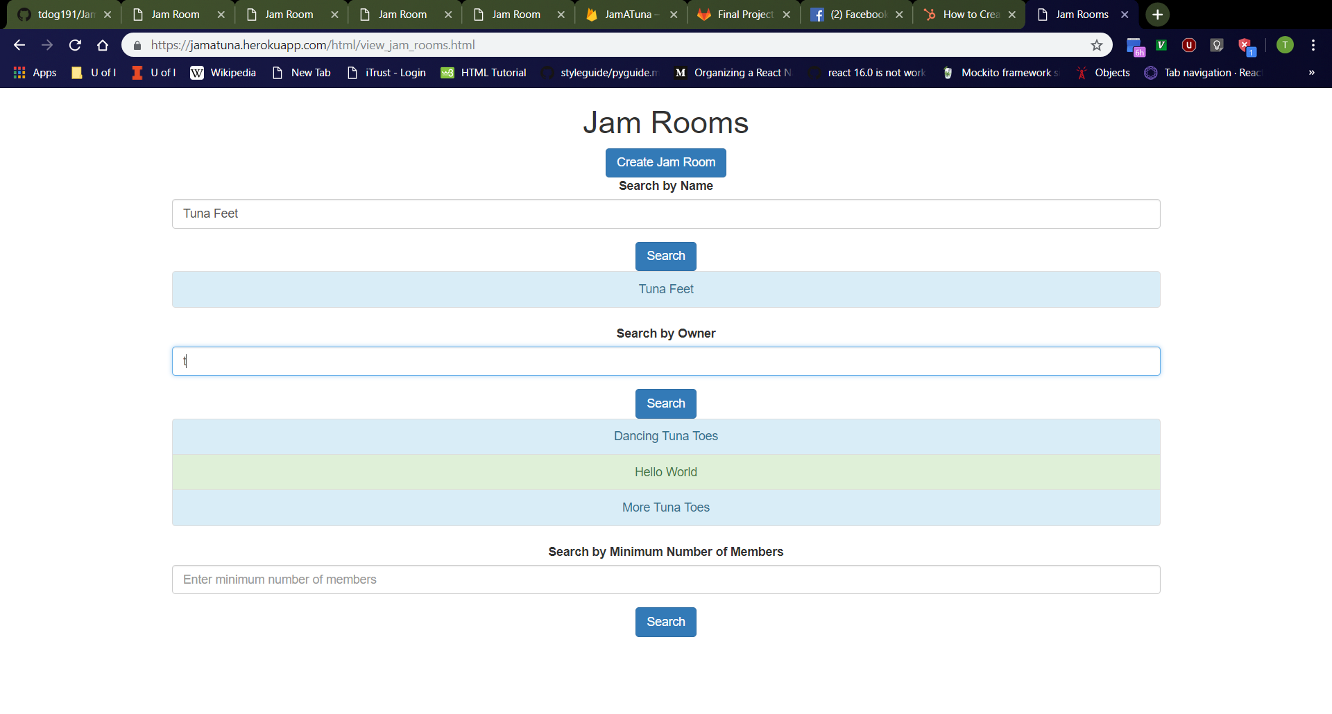
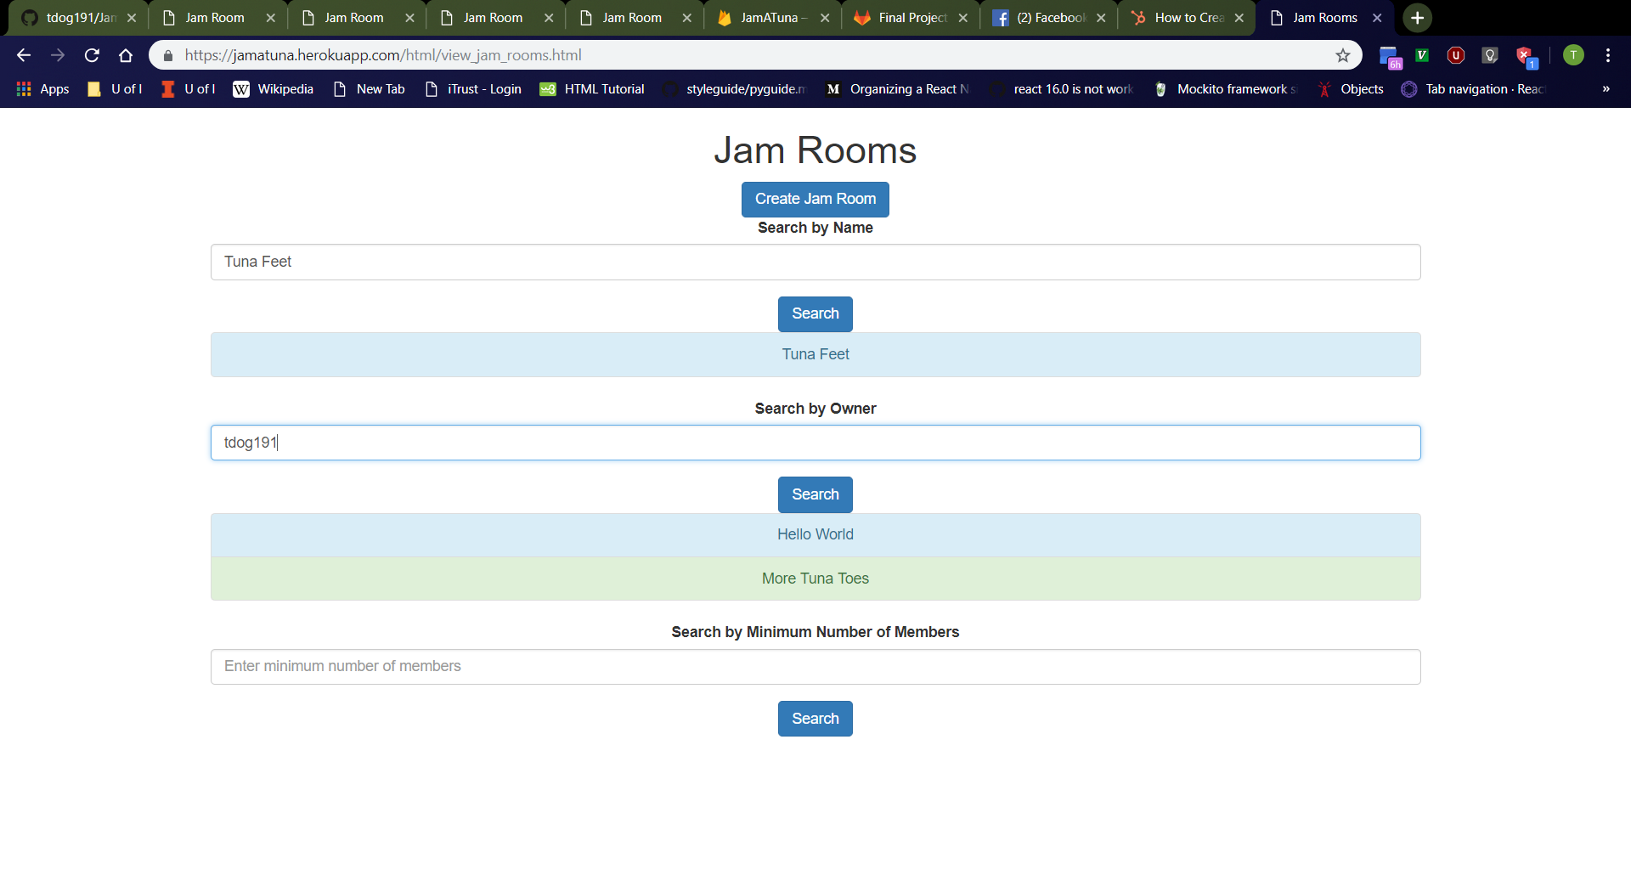
Jam Room Search (Search by Owner)
First Search
Enter “t” (or other prefix (ignoring case) of a jam room owner username in the database) into “Search by Owner” bar and click “Search” button immediately below.
Should see list of all jam rooms in database with owners that have usernames with matching prefixes (ignoring case)
Odd-numbered entries should be colored light-blue while even-numbered entries are colored light-green.
Enter “tdog191” (or other jam room owner username in database) into “Search by Owner” bar and click “Search” button immediately below.
Old search results should disappear, and the new search results should be displayed.
Second Search

Slide 30
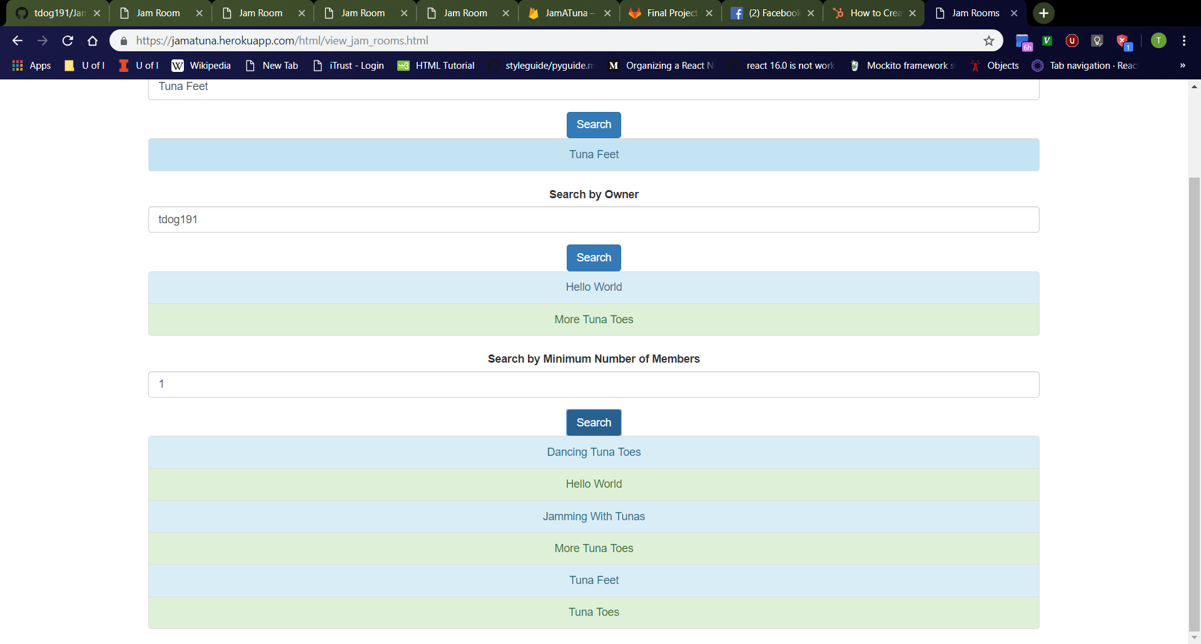
Jam Room Search (Search by Minimum Number of Members)
First Search
Enter “1” into “Search by Minimum Number of Members” bar and click “Search” button immediately below.
Should see list of all jam rooms in database (since every jam room has its owner as a member, thereby meeting the minimum number of members 1)
Odd-numbered entries should be colored light-blue while even-numbered entries are colored light-green.
Enter “2” into “Search by Minimum Number of Members” bar and click “Search” button immediately below.
Old search results should disappear, and the new search results should be displayed.
Second Search

Slide 31
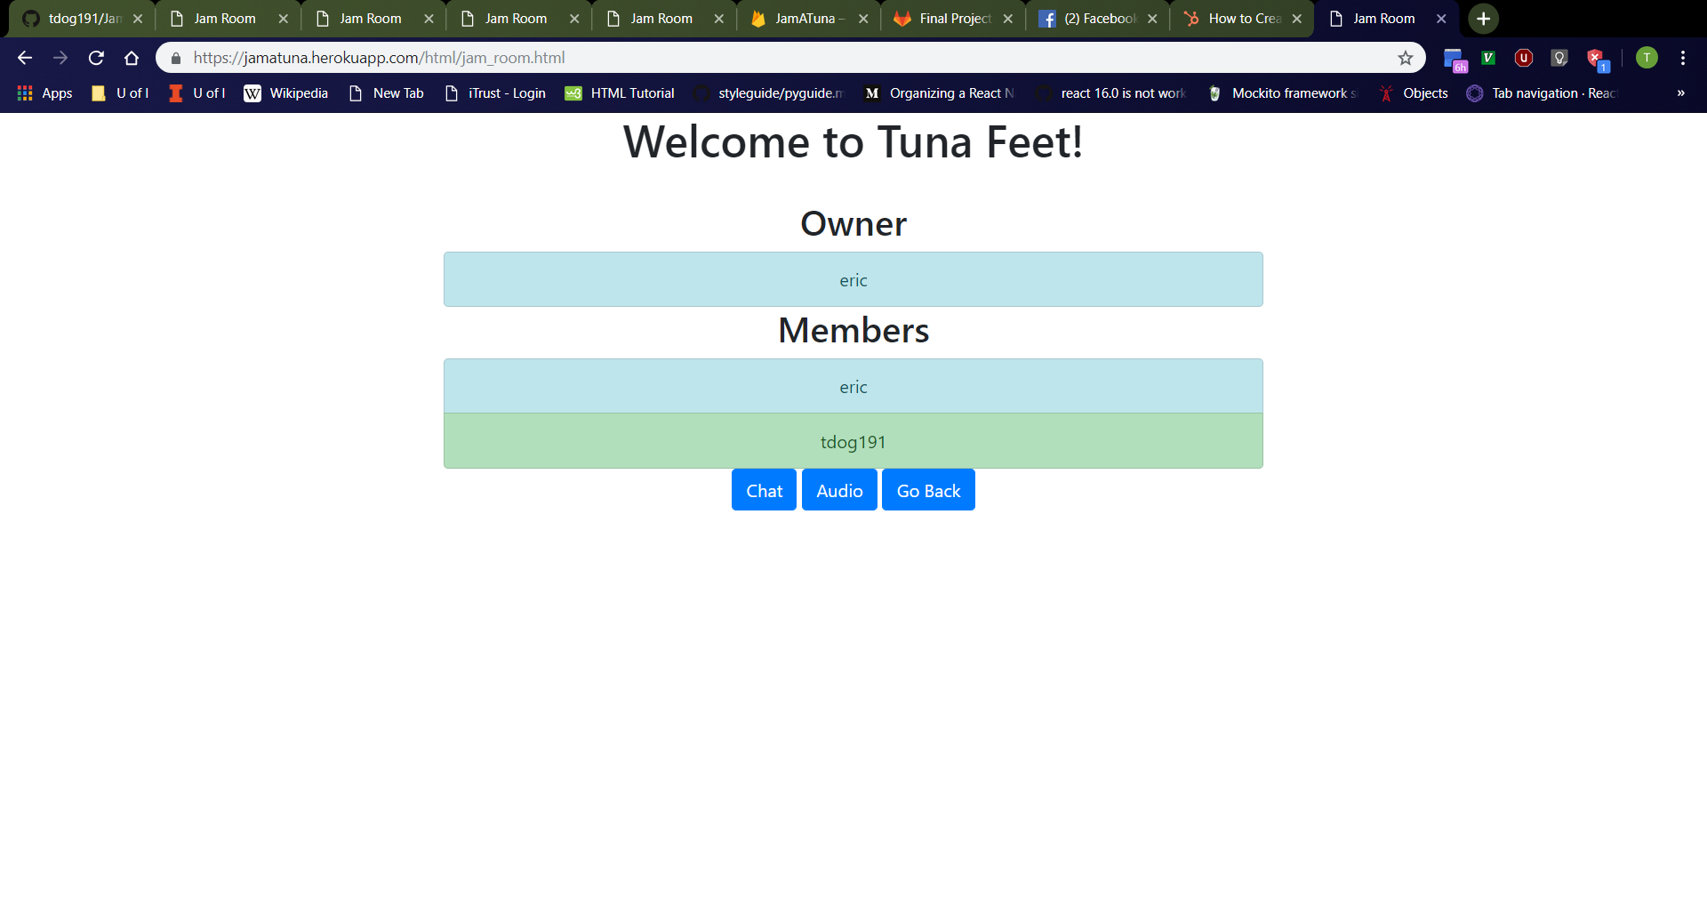
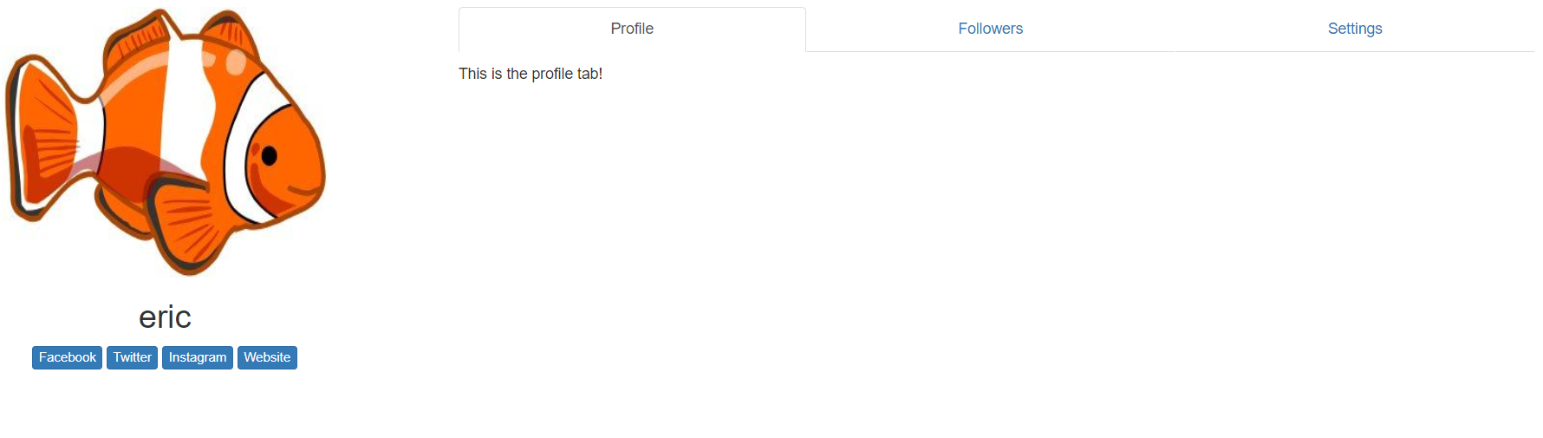
Jam Room Page
Jam Room Page
Click “Tuna Feet” (or other search result entry on “Jam Rooms” page).
Should navigate to http://localhost:3000/html/jam_room.html
From top to bottom, should see “Welcome to <name of jam room>!” header, “Owner” header, clickable light-blue rectangle containing the username of the jam room’s owner, “Members” header, list of all members in the jam room, then “Chat”, “Audio”, and “Go Back” buttons
Odd-numbered entries of the members list should be colored light-blue while even-numbered entries are colored light-green.
Click any user entry on the page
Should navigate to corresponding user’s profile page
Click “Go Back” button
Should navigate to http://localhost:3000/html/view_jam_rooms.html
After Selecting User

Slide 32
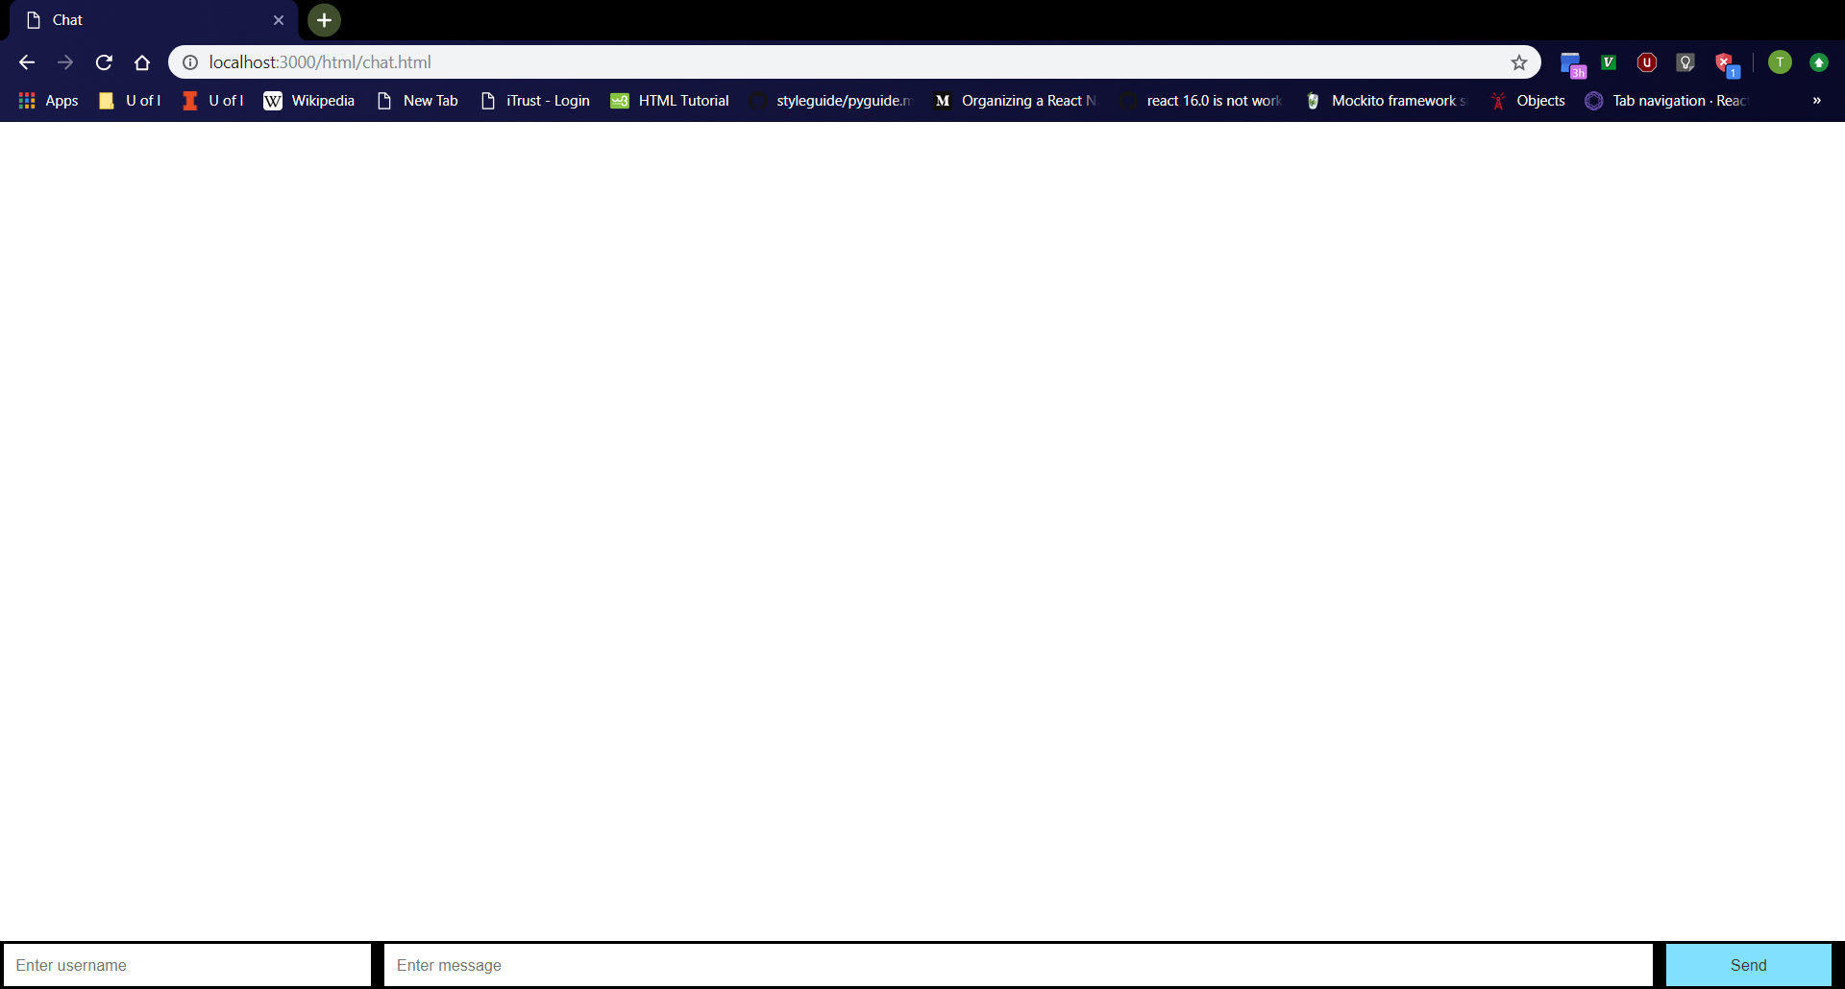
Chat Page
Click “Chat” button on jam room page.
Should navigate to http://localhost:3000/html/chat.html
From left to right at the bottom of the page, should see username box, message box, then “Send” button
Username box should be empty with “Enter username” placeholder.
Message box should be empty with “Enter message” placeholder.

Slide 33
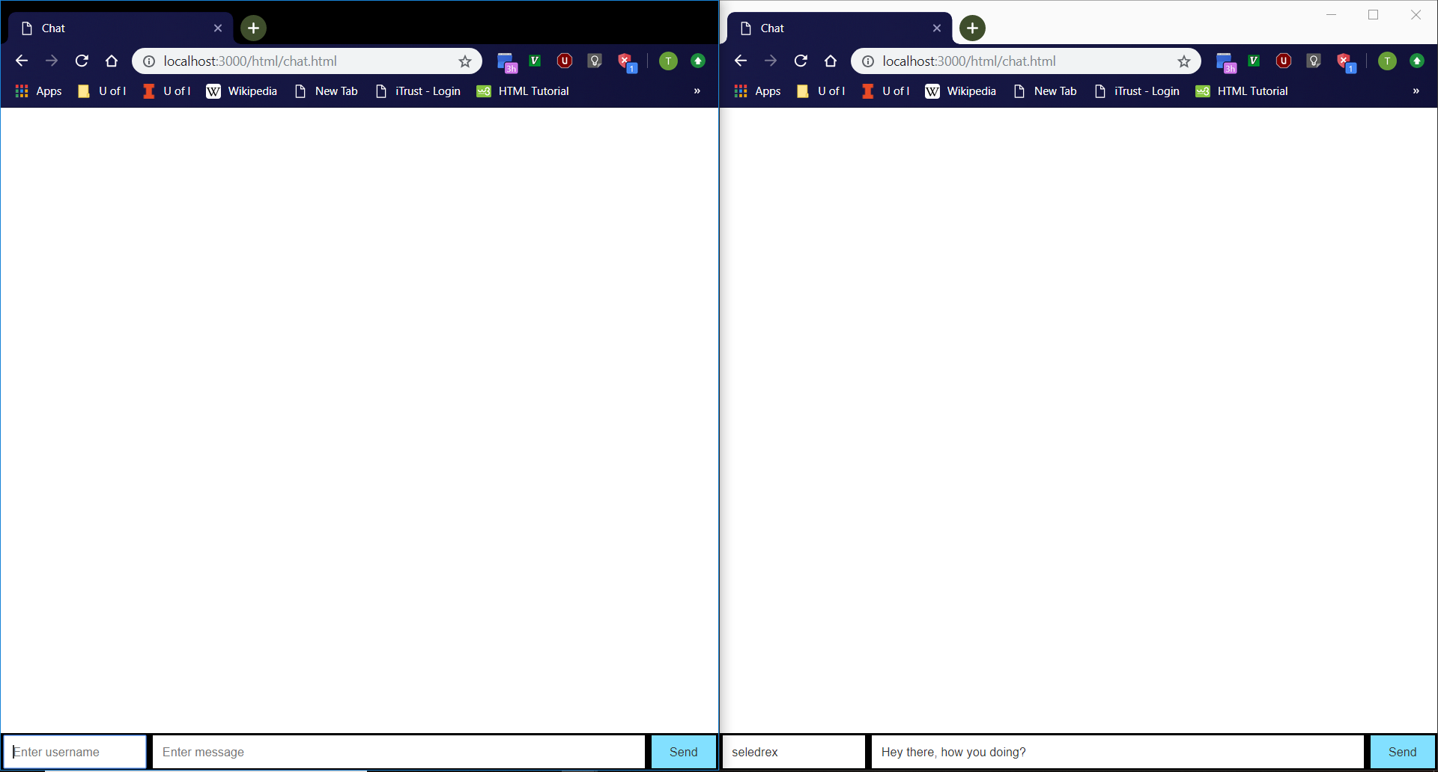
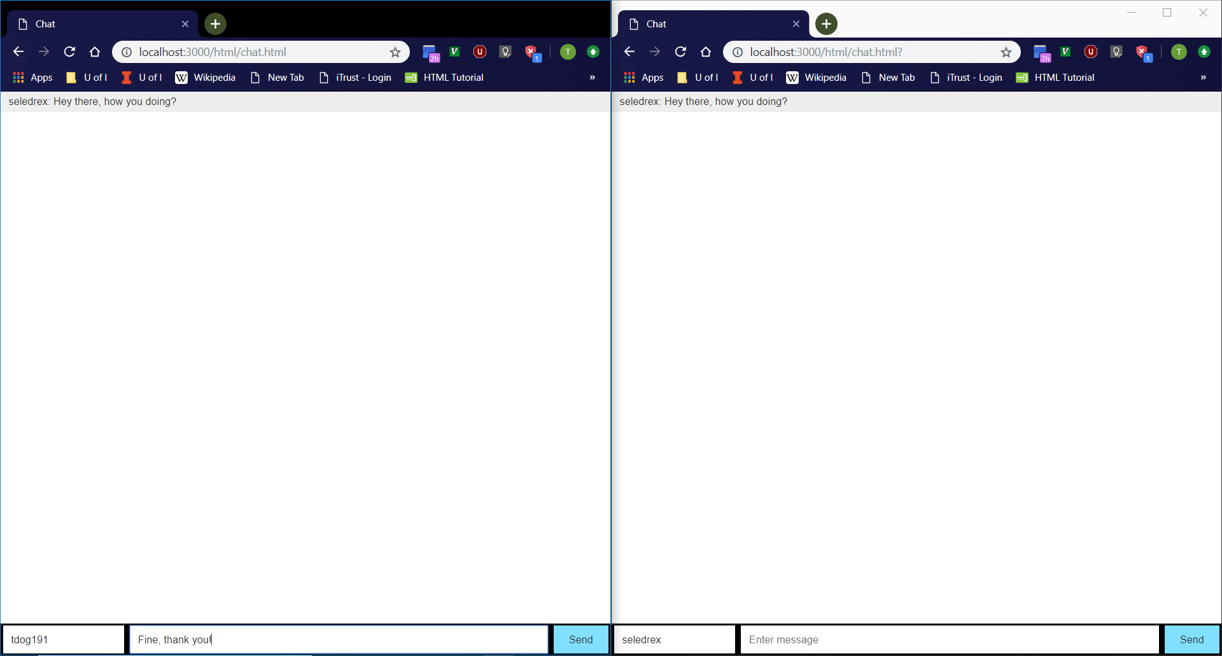

Chat Page Cont.
Open chat page in two browser tabs.
Type username and messages into either tab and hit ‘Enter’.
Messages should show on both tabs.
Every sent message should be of the form “<username>: <message>”.
Every odd-numbered message should have a gray background.
Message box should become empty after a message is sent.
Messages should not appear to any user outside the jam room.

Slide 34
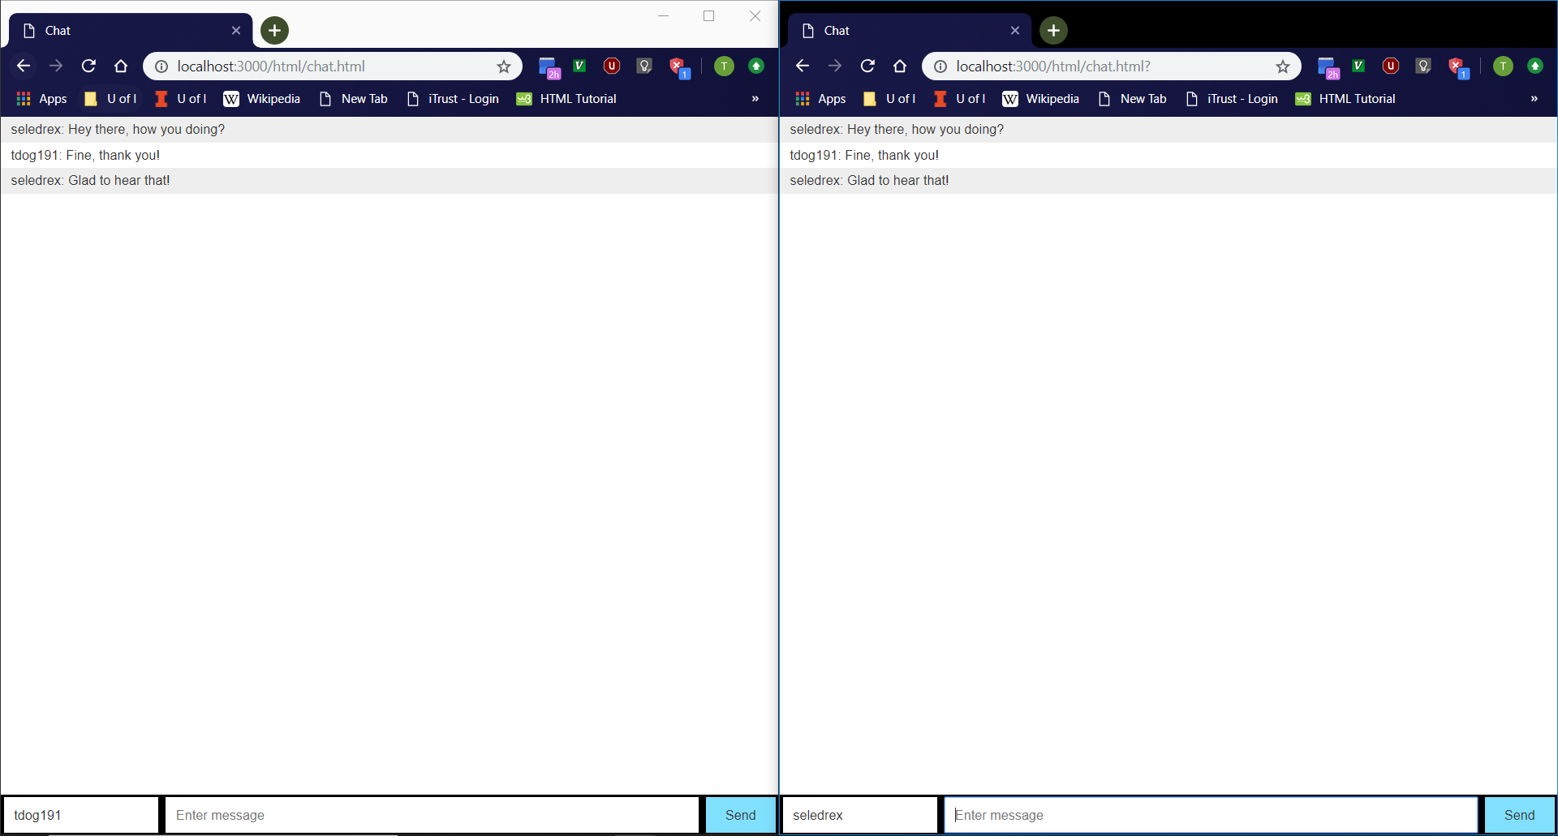
Chat Page Example
Step 1
Step 2
Step 4
Step 3

Slide 35
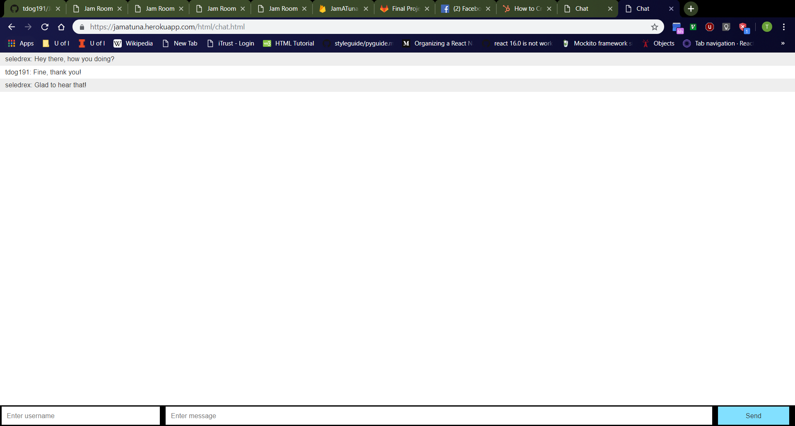
Reloading Chat Page
Refresh the chat page
Should see chat messages reload onto the screen

Slide 36
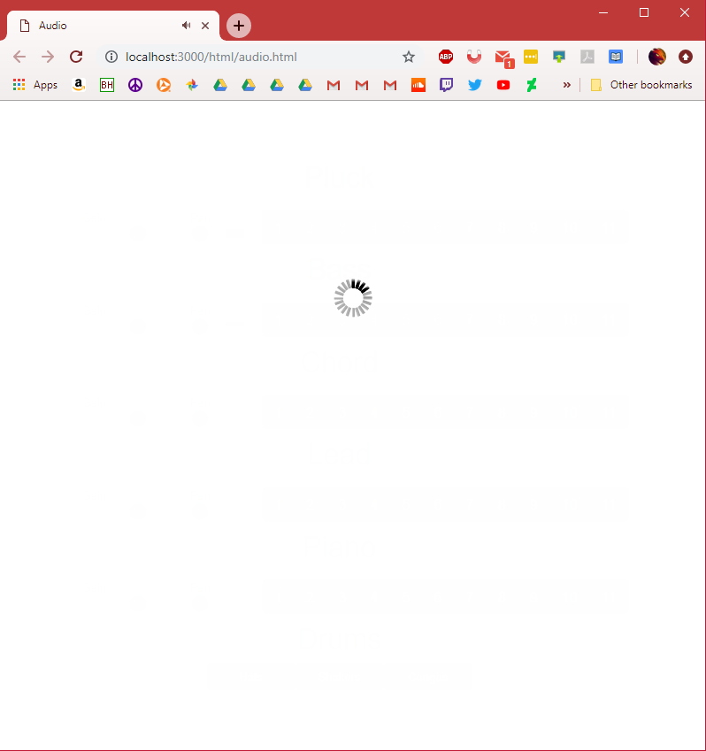
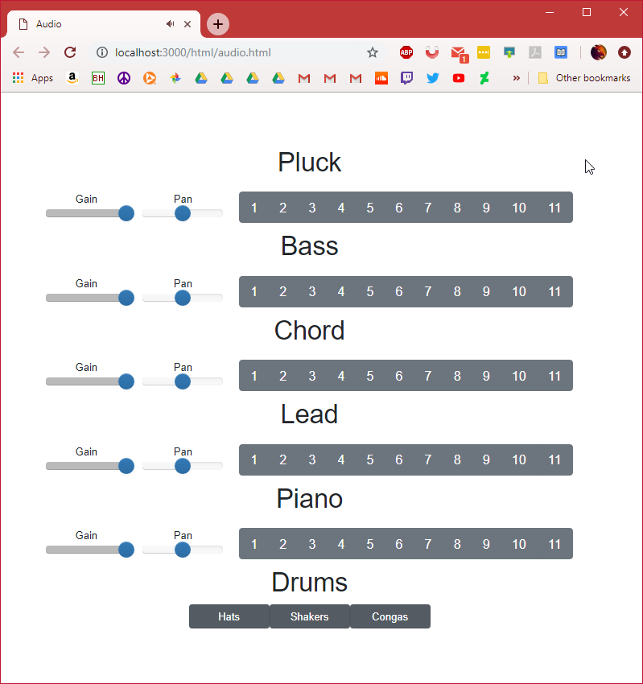
Audio Page
Navigate to http://localhost:3000/html/audio.html
Loading screen should appear first
Should see title and buttons centered in screen after
Drum beat should start

Slide 37
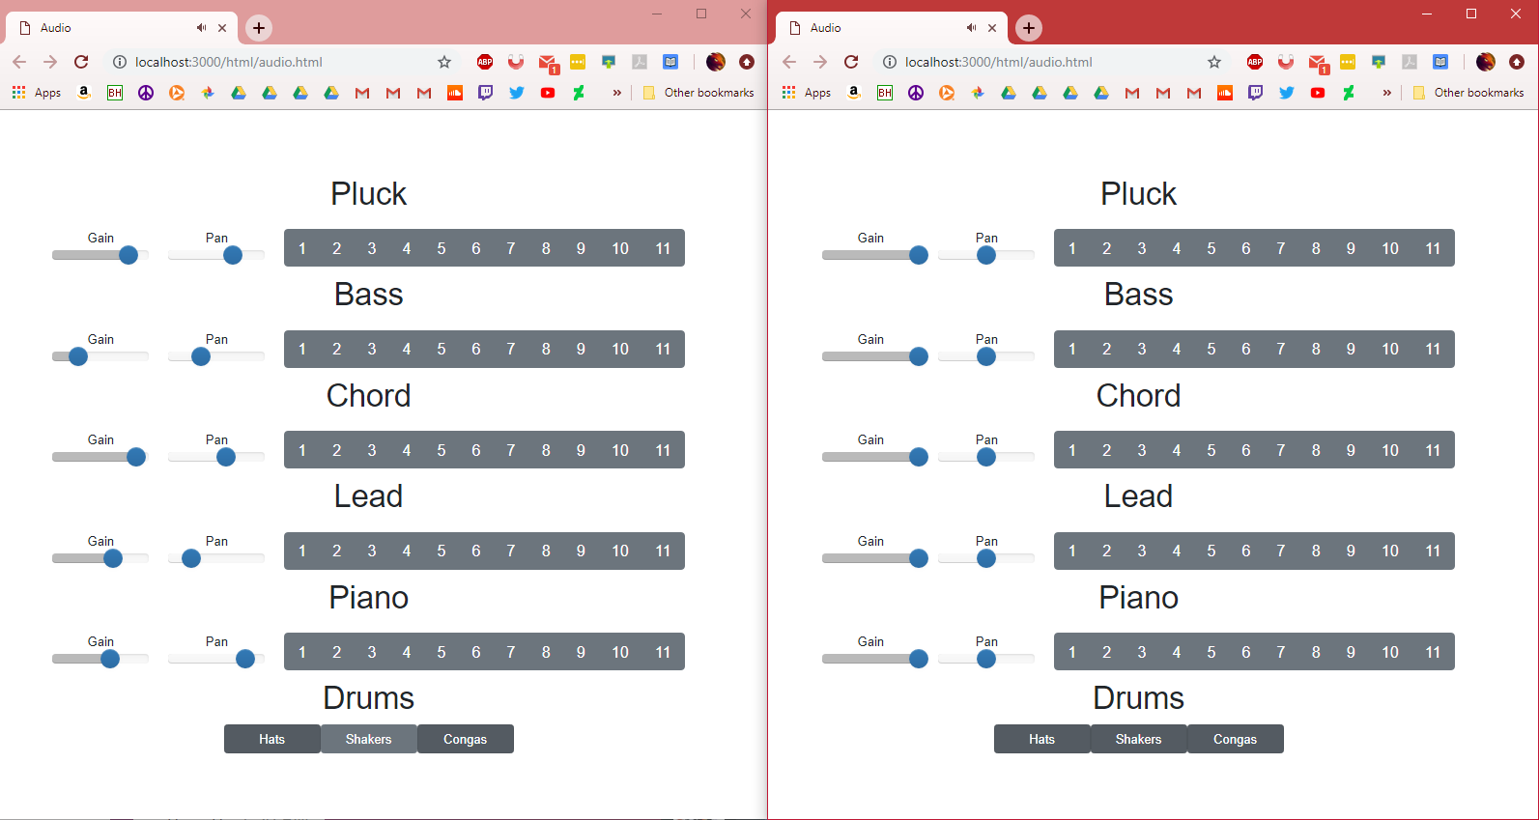
Audio Page
Continued
Pressing a button on either tab will play an audio file
Audio files should be played on both tabs
Sound should be in sync no matter how irregular clicks are made
Gain and pan sliders should work
Audio files should not be played to any user outside the jam room.

Slide 38
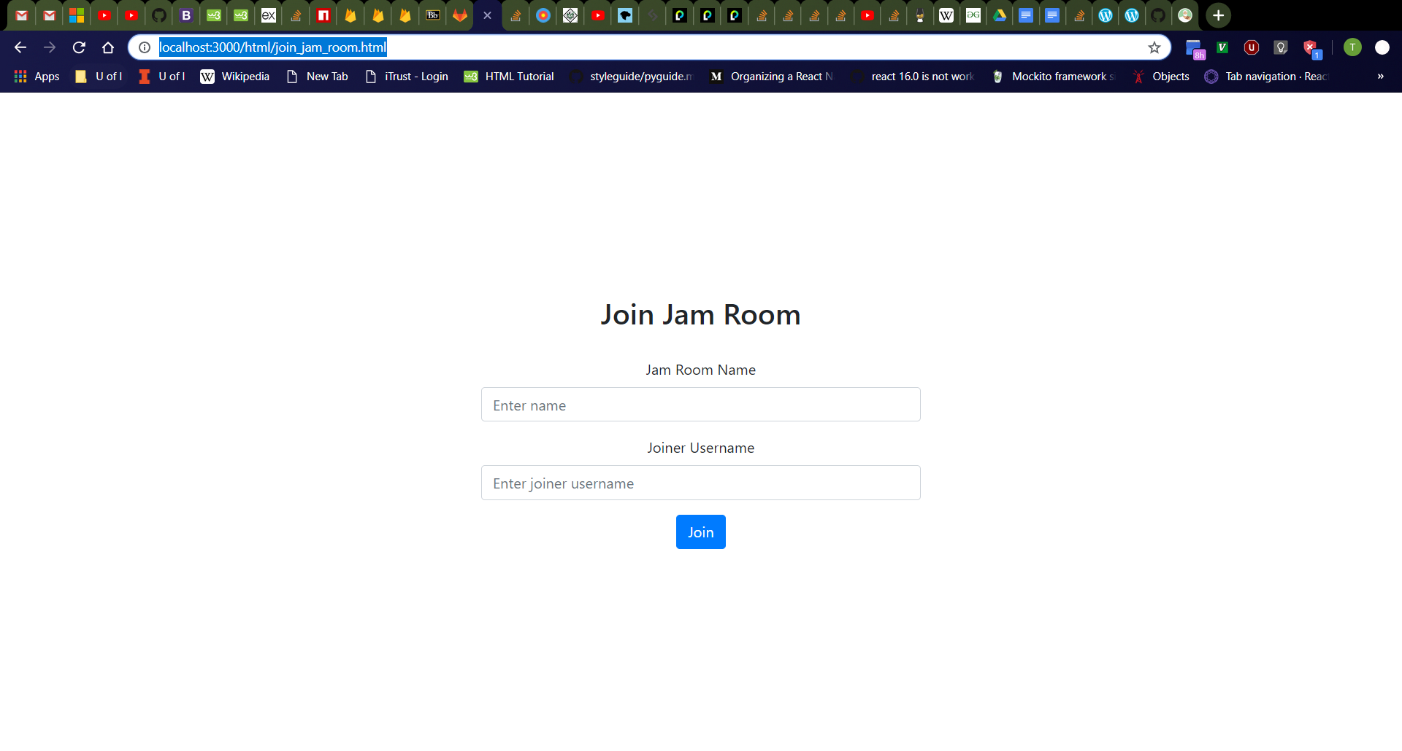
Join Jam Room Page
Click “Join Jam Room” button on home page.
Should navigate to http://localhost:3000/html/join_jam_room.html
From top to bottom, should see “Join Jam Room” header, jam room name box with label, joiner username box with label, then “Join” button
Jam room name box should be empty with “Enter name” placeholder.
Joiner username box should be empty with “Enter joiner username” placeholder.

Slide 39


Join Jam Room Page Error Messages
Click jam room name box, then joiner username box, then click away.
Should see jam room name and joiner username boxes turn red with red “Jam room name cannot be empty.” and “Joiner username cannot be empty.” messages respectively
Refresh the page then click the “Join” button
Should see red error messages again
Validation checks for empty jam room name and joiner username boxes should always occur as user releases keyboard keys, the boxes lose focus, and when the “Join” button is clicked.
Empty Jam Room Name
All boxes empty

Slide 40

Join Jam Room Page (Jam Room Does Not Exist)
Enter the following values in the jam room joining page:
Jam Room Name: “Singing Tuna” (or other nonexistent jam room in database)
Joiner Username: “tdog191”
Should see new page with message “That jam room does not exist.” and “Try Again” button.

Slide 41

Join Jam Room Page (Joiner Username Does Not Exist)
Click “Try Again” button
Should navigate to http://localhost:3000/html/join_jam_room.html
Enter the following values in the jam room joining page:
Jam Room Name: “Dancing Tuna Feet” (or other existing jam room in database)
Joiner Username: “salt” (or other nonexistent user in database)
Should see new page with message “That joiner username does not exist.” and “Try Again” button.

Slide 42

Join Jam Room Page (Success)
Click “Try Again” button
Should navigate to http://localhost:3000/html/join_jam_room.html
Enter the following values in the jam room joining page:
Jam Room Name: “Dancing Tuna Feet” (or other existing jam room in database)
Joiner Username: “tdog191” (or other existing user in database)
Should see new page with message “Successfully joined jam room!” and “Go Back” button.

Slide 43

Audio
Check layout
Jam room title appears
Home and Back button appear
HTML5 Canvas appear
Gain knobs appear
Pan knobs appear
Drum toggles appear

Slide 44
Audio
Test buttons
Home returns to home page
Back returns to last page
Test toggles
Turn on and off hats
Turn on and off shakers
Turn on and off congas

Slide 45

Audio
Test canvas
Entering canvas, mouse pointer changes to hand
Leaving canvas, mouse pointer changes back to default
Hovering over a button tile will change its brightness
Smooth fade in and fade out

Slide 46
Audio
Test canvas con.
Clicking a button tile will produce a sound
Hold clicking a button tile will repeatedly produce sounds
Every sound will be on the beat playing 1/8 notes
Holding left click while moving to other tiles will continue to produce sounds
Hold click will persist even if canvas is exited

Slide 47
Audio
Test encoders
Gain knob will change corresponding column’s gain
Logarithmic scaling
Pan knob will change corresponding column’s pan position
Left and right sounding
After changing the gain and pan, play sounds for the corresponding column
Should sound as expected

Slide 48


Audio
Tab 1
Test multiplayer
Open two tabs (Tab 1, Tab 2)
Clicking on a button tile in Tab 1 will make a sound play in Tab 2 as well as the corresponding tile pulse white
Smooth pulse
Audio should be in sync on Tab 2
Gain, Pan, and Drum toggles work per client
Tab 2

